Slide 1
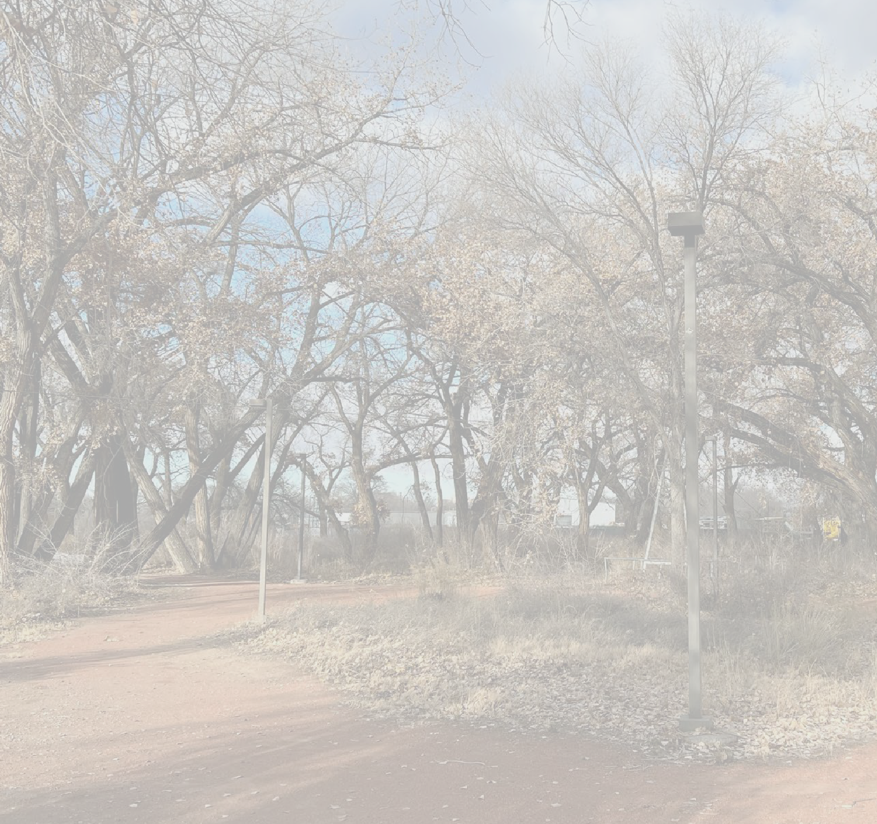
ANIMAS
ACTION PLAN
Community Input Workshop
Kickoff Meeting | March 21, 2023

Slide 2
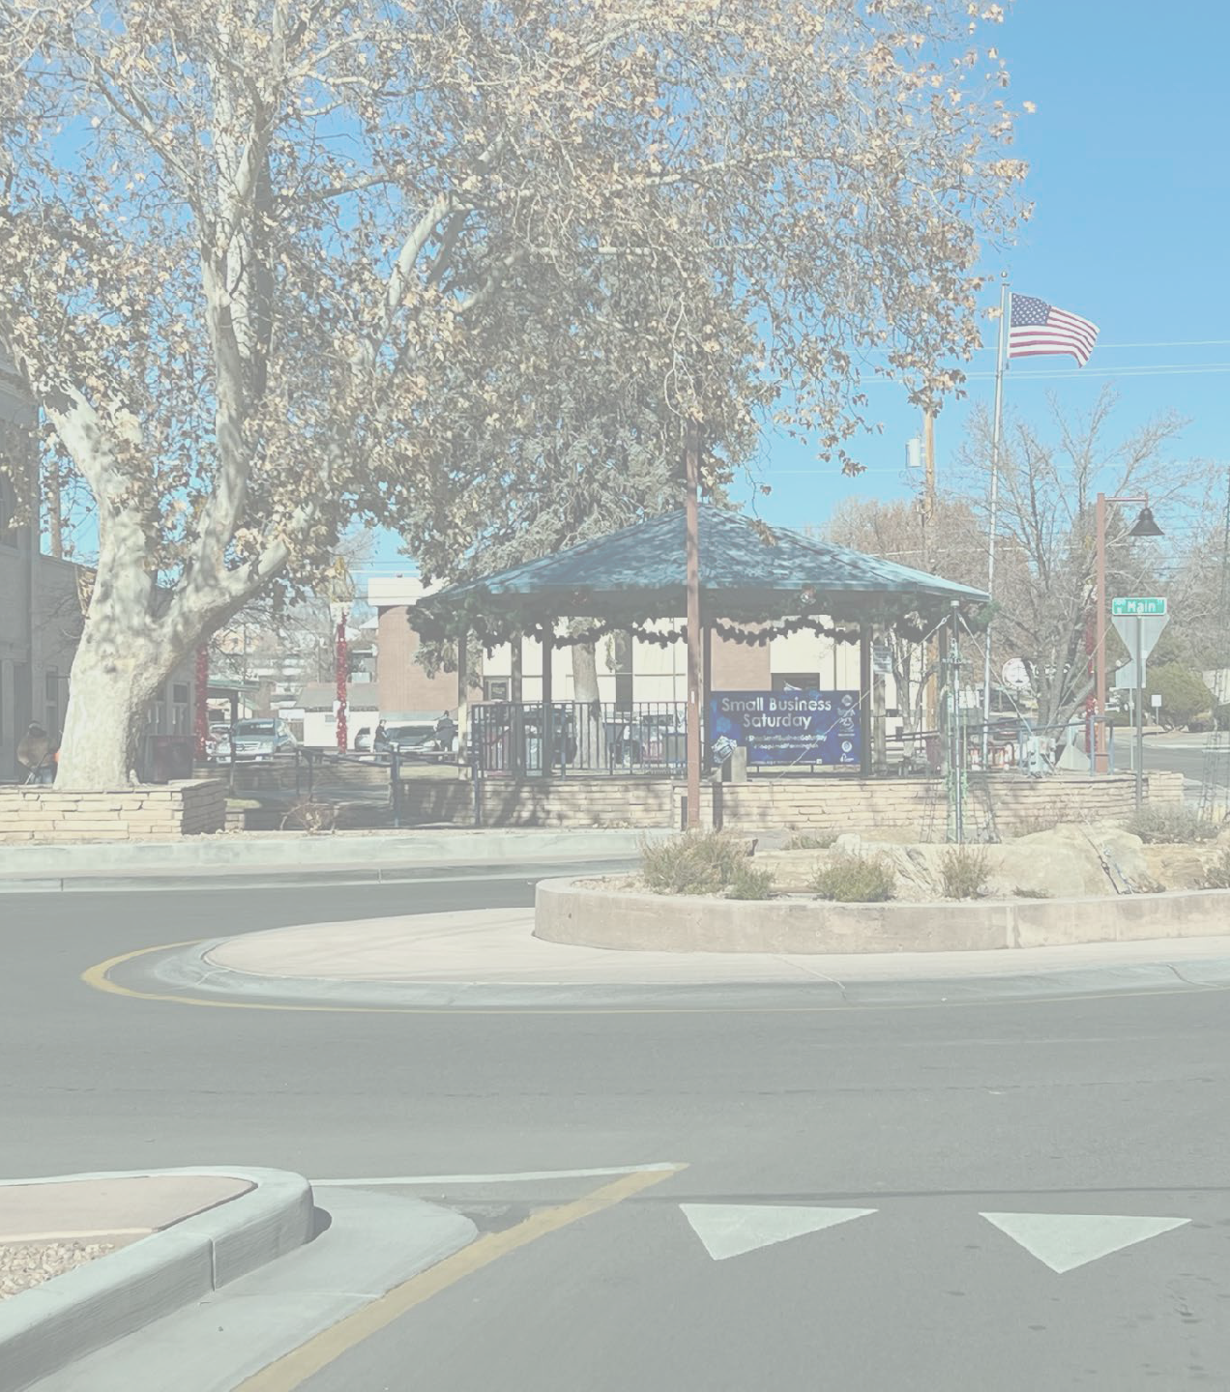
INTRODUCTION
COMMUNITY INPUT WORKSHOP
Project Team and Purpose​
Project Background​
Table Activities
Next Steps​
C I T Y O F F A R M I N G T O N

Slide 3
PROJECT TEAM
COMMUNITY INPUT WORKSHOP
SITES SOUTHWEST – Planning, Project Mgmt
CIVIC PLAN STUDIO – Urban Design, Planning Policy
TXP – Market Analysis, Public Strategy
ZANETTA ILLUSTRATION – Final Renderings
F A R M I N G T O N
O F
C I T Y

Slide 4
WORKSHOP SCHEDULE
COMMUNITY INPUT WORKSHOP
DAY 1 – March 21
Team field work
Kickoff Meeting @ 5:30
Existing Conditions
Table Exercises
DAY 2 – March 22
Design time & draft scenarios
Interim pin-ups for review
DAY 3 – March 23
Final check-in with staff
Final Open House @ 5:30
Present scenarios
Community review
F A R M I N G T O N
O F
C I T Y

Slide 5
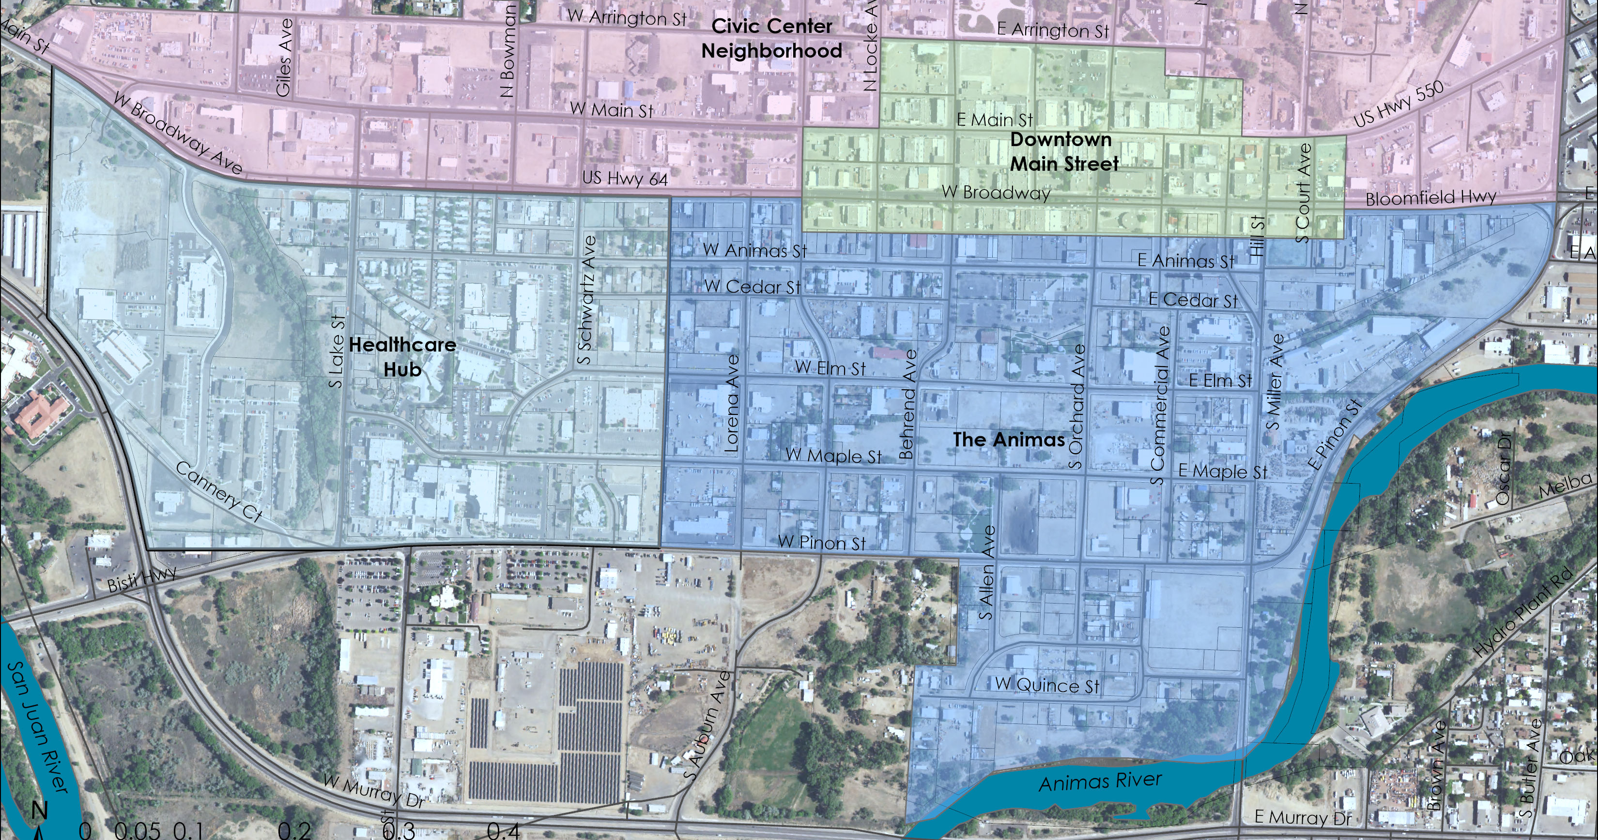
PROJECT AREA
COMMUNITY INPUT WORKSHOP
F A R M I N G T O N
O F
C I T Y
S AMPLE CAP TION

Slide 6
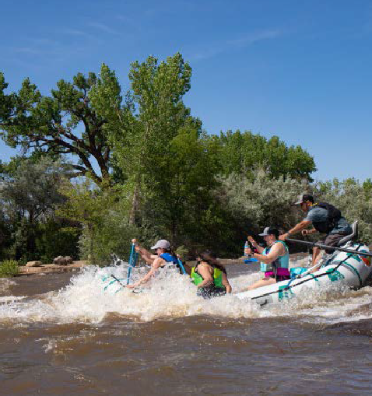
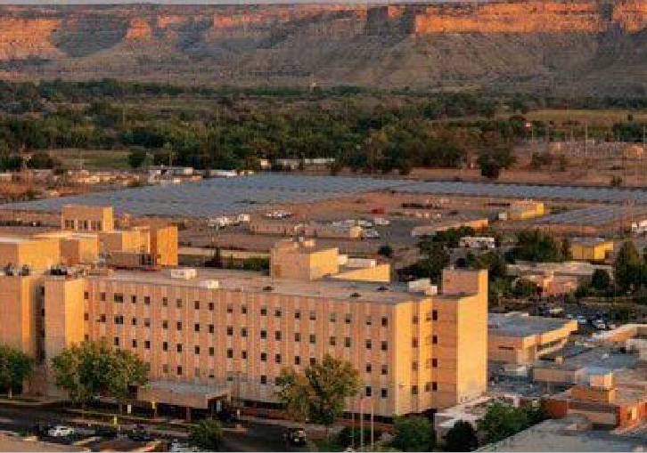
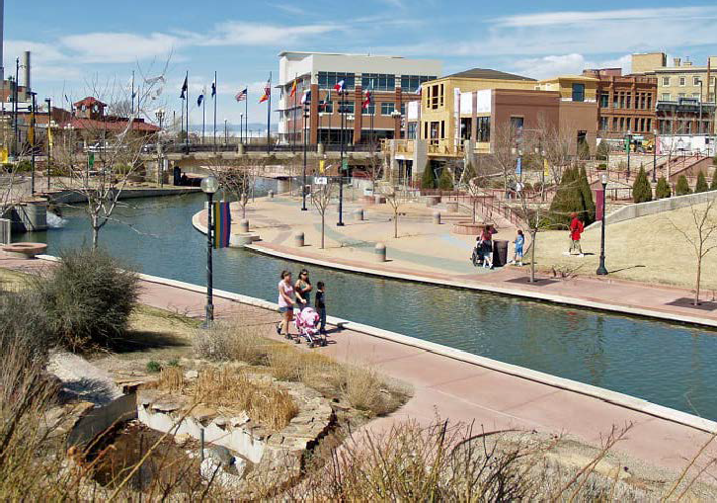
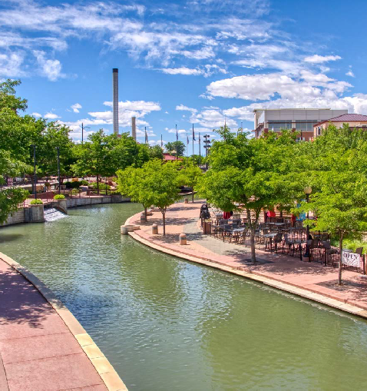
PROJECT PURPOSE
COMMUNITY INPUT WORKSHOP
DRAFT GOALS
Create a realistic framework for future development in the Healthcare Hub and Animas Area
Identify catalytic projects to help spur development
Provide a common identity that builds on the history of the area, as well as goals for its future
F A R M I N G T O N
O F
C I T Y
S AMPLE CAP TION

Slide 7
ENGAGEMENT TO-DATE
COMMUNITY INPUT WORKSHOP
December Site Visit
Focus Groups held with: Economic Development, SJRCM, Realtors and Developers, Local Businesses and Organizations
Stakeholder Interviews
SJC Cooperative Extension Office
City Engineers
Indian Center
F A R M I N G T O N
Project Website
www.animasactionplan.org
Community Survey
Planning to open late February through March
O F
C I T Y
S AMPLE CAP TION

Slide 8
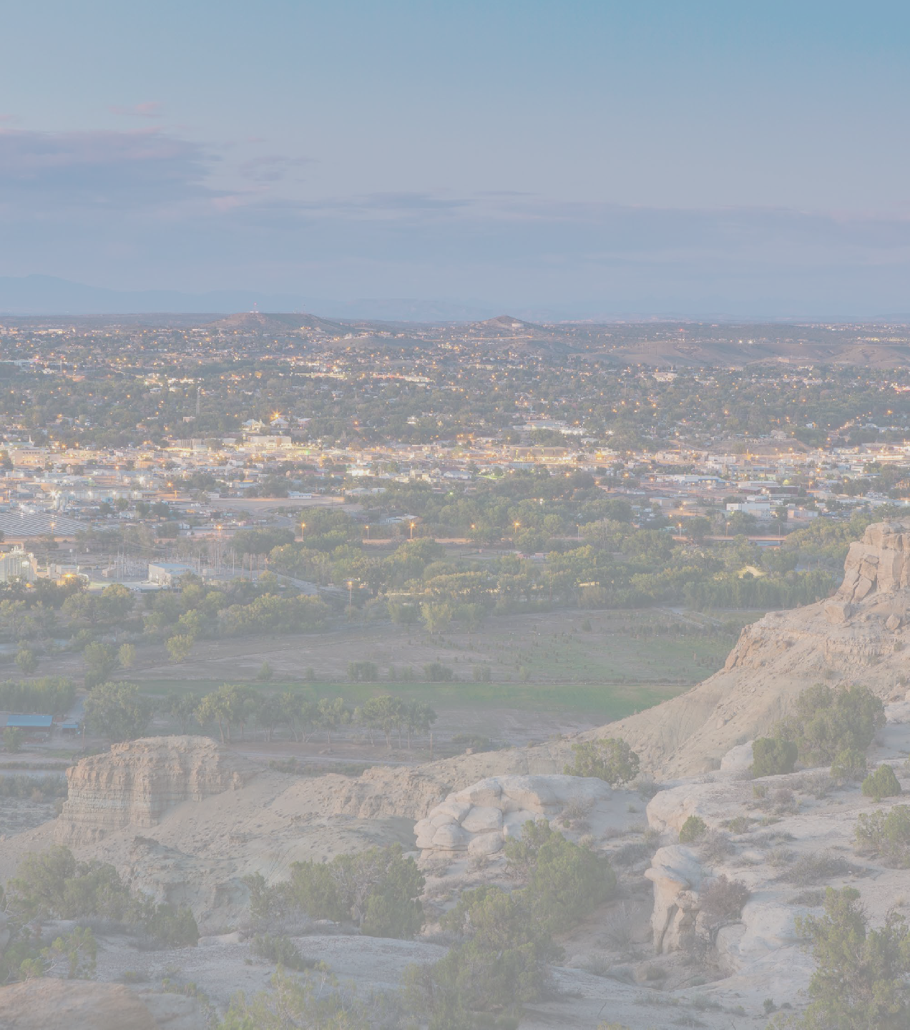
BACKGROUND
COMMUNITY INPUT WORKSHOP
Farmington Comprehensive Plan, 2021
Downtown MRA Plan, 2019
Farmington MPO Bicycle and Pedestrian Plan, 2019
Riverine Corridor Plan, 1990
River Reach R/UDAT Report, 1986
C I T Y O F F A R M I N G T O N

Slide 9
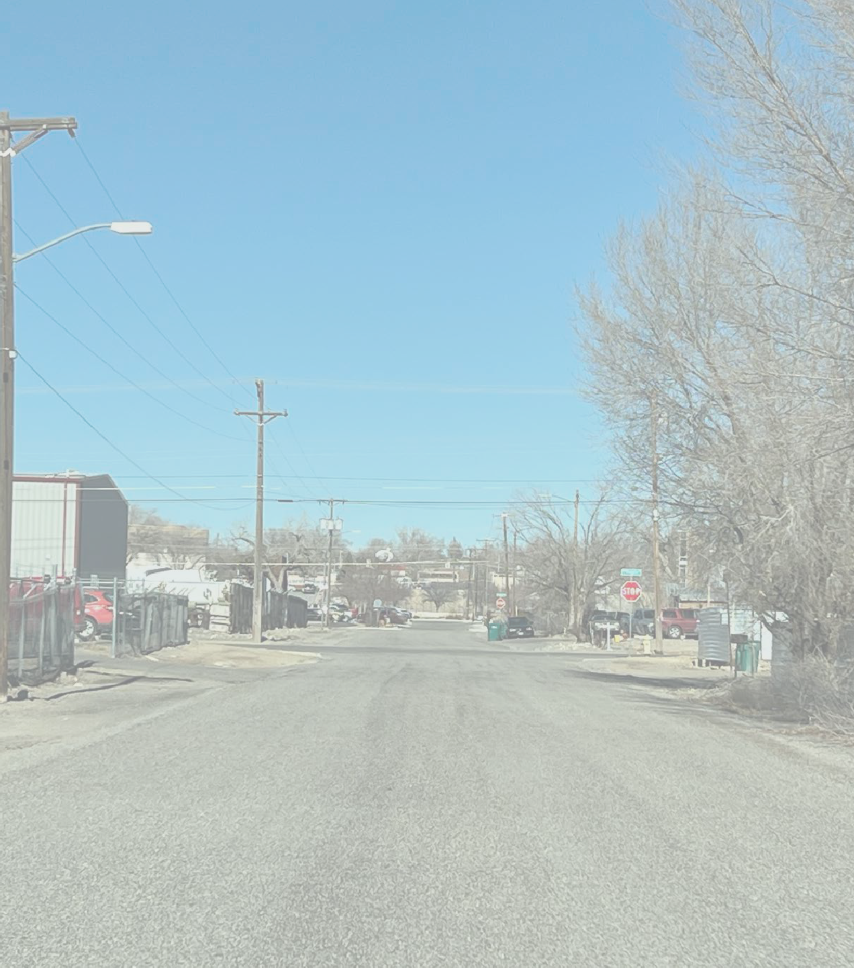
PHYSICAL
COMMUNITY INPUT WORKSHOP
CONDITIONS
C I T Y O F F A R M I N G T O N

Slide 10
CHARACTER ZONES ANALYSIS
COMMUNITY INPUT WORKSHOP
CHARACTER ZONES
This diagram shows the existing character zones that have been observed on the ground. There are no hard boundaries between the zones.
Each zone comes with its set of opportunities and challenges that will be addressed as part of the planning process.
F A R M I N G T O N
O F
C I T Y

Slide 11
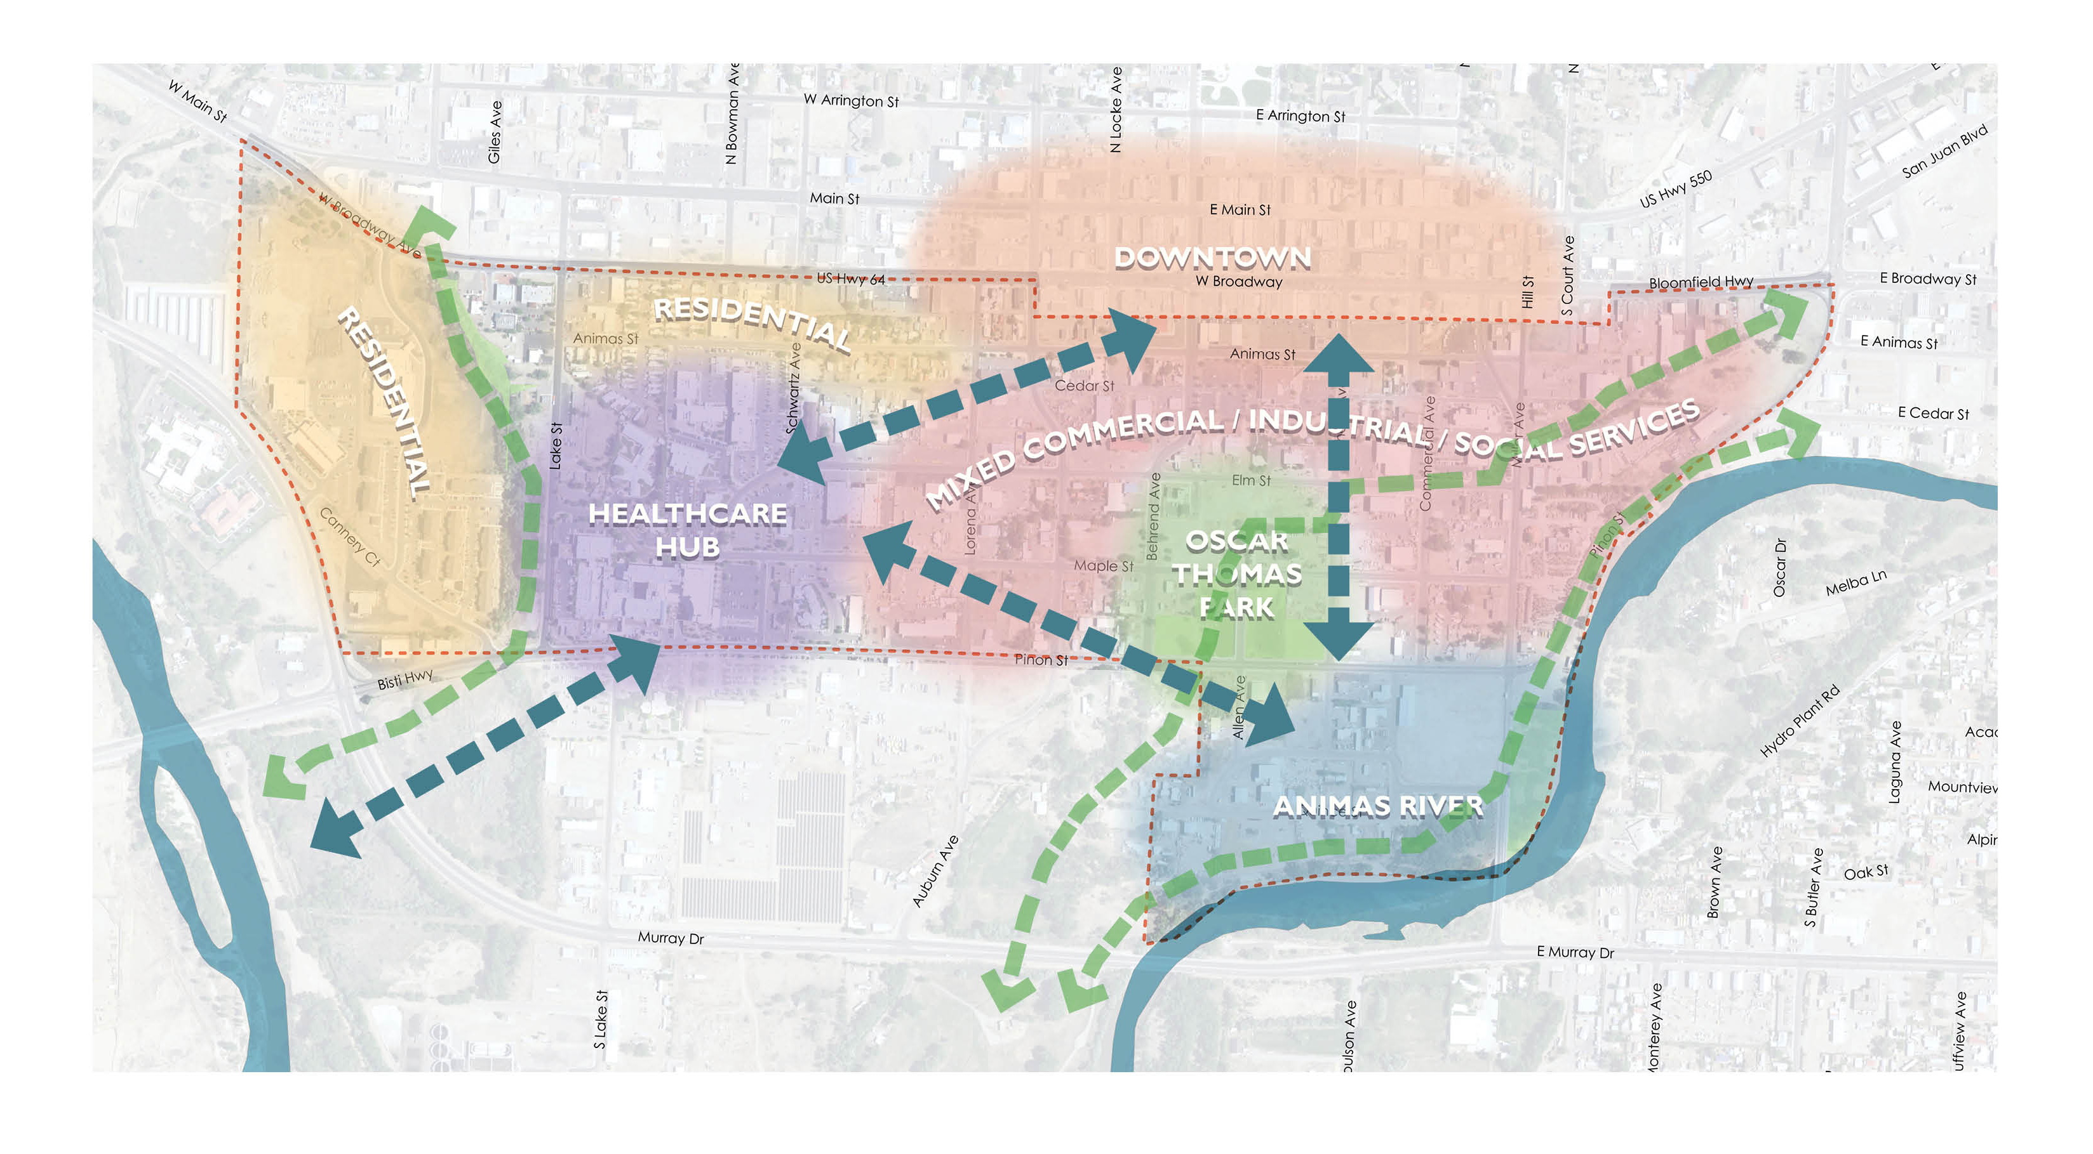
CHARACTER ZONES ANALYSIS
COMMUNITY INPUT WORKSHOP
MAKING CONNECTIONS
A key objective of this plan will be to strengthen connections between the three primary destinations, downtown, the Animas River and the San Juan Regional Medical Center.
This can be achieved by multi-modal
improvements to the existing street network and by utilizing existing drainage paths to create greenway connections.
F A R M I N G T O N
O F
C I T Y

Slide 12
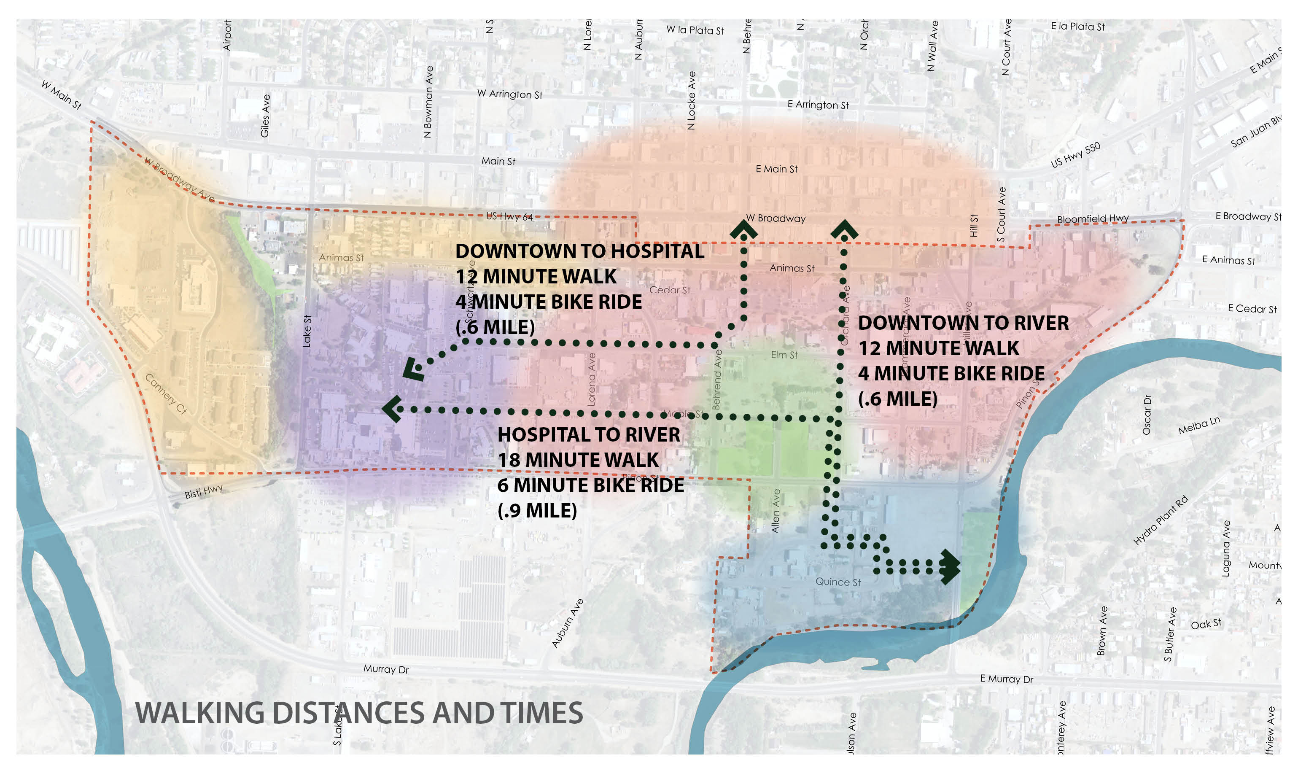
WALKABILITY
COMMUNITY INPUT WORKSHOP
DISTANCE BETWEEN DESTINATIONS
This diagram shows the approximate distances between the areas three major destinations. While each segment might be perceived as a long walk, they are good candidates for a bike ride or other form of micromobility.
F A R M I N G T O N
O F
C I T Y

Slide 13
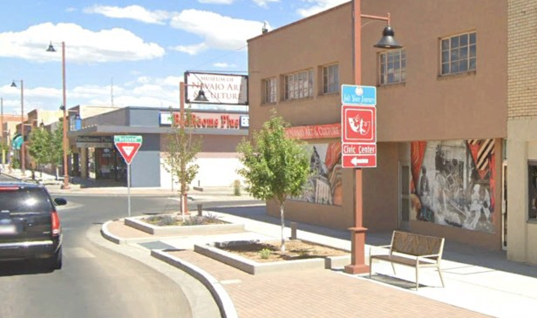
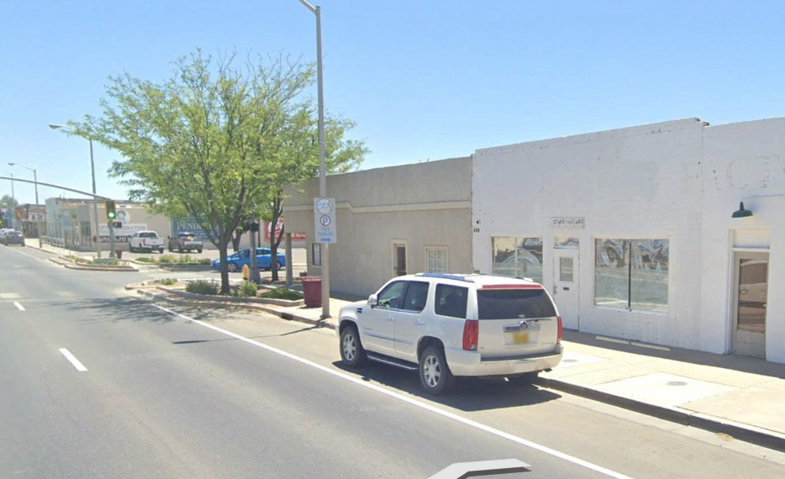
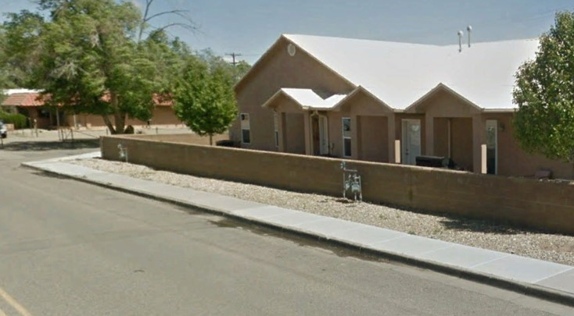
EXISTING PEDESTRIAN FACILITIES
This diagram highlights the missing sidewalks (dark red). In order to create a desirable development context, improvements within the pedestrian network are recommended. Because of the scale of the issue, innovative and incremental solutions may be warranted.
COMMUNITY INPUT WORKSHOP
Grade A sidewalk: Provides several of the following elements: shade, protection from moving traffic (trees and on-street parking), seating, lighting, and bike racks.
Grade B sidewalk: Provides only one or two of the elements listed above.
O F
C I T Y
Grade C sidewalk: provides a physical walking space with no amenities.

Slide 14
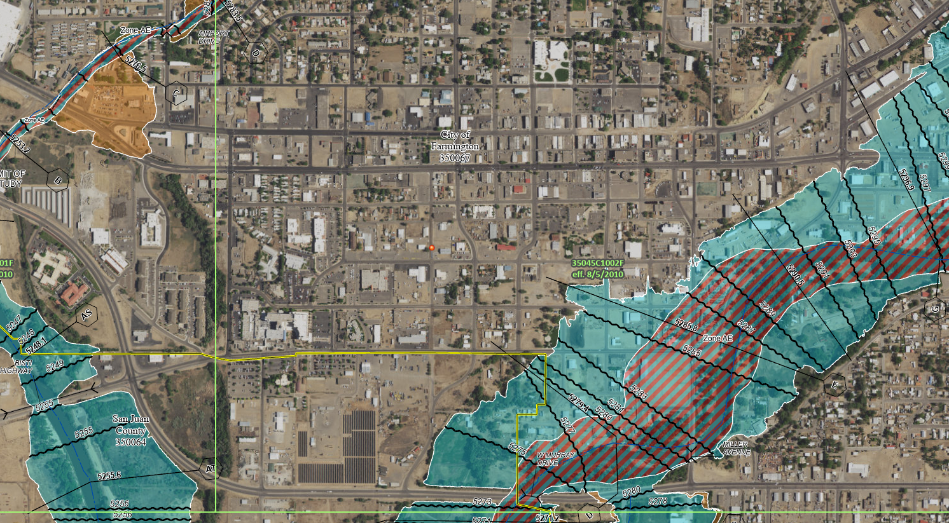
FLOODWAY
COMMUNITY INPUT WORKSHOP
FLOOD MAP
The map shows two designations for flood management that encroach in the study area.
The Zone AE hatched area falls within the FLOODWAY. As such, any changes to the site must be approved by FEMA. Buildings should be minimized in the area and must be engineered to be either wet or dry floodproofed. Housing should not be considered for this area.
The blue area indicates the Flood Plan. Buildings must be constructed a minimum of one foot above the base floor elevation. Open areas under the building may be used for parking.
F A R M I N G T O N
O F
C I T Y

Slide 15
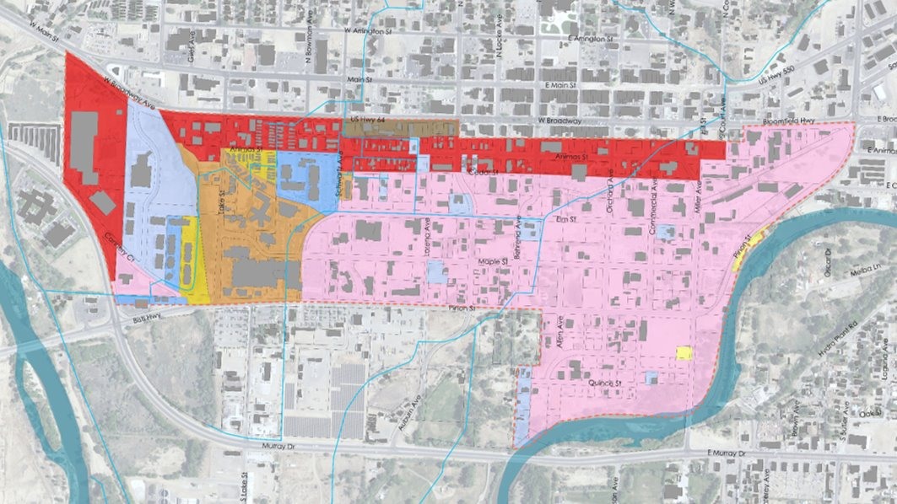
Current Zoning Map
COMMUNITY INPUT WORKSHOP
F A R M I N G T O N
O F
C I T Y

Slide 16
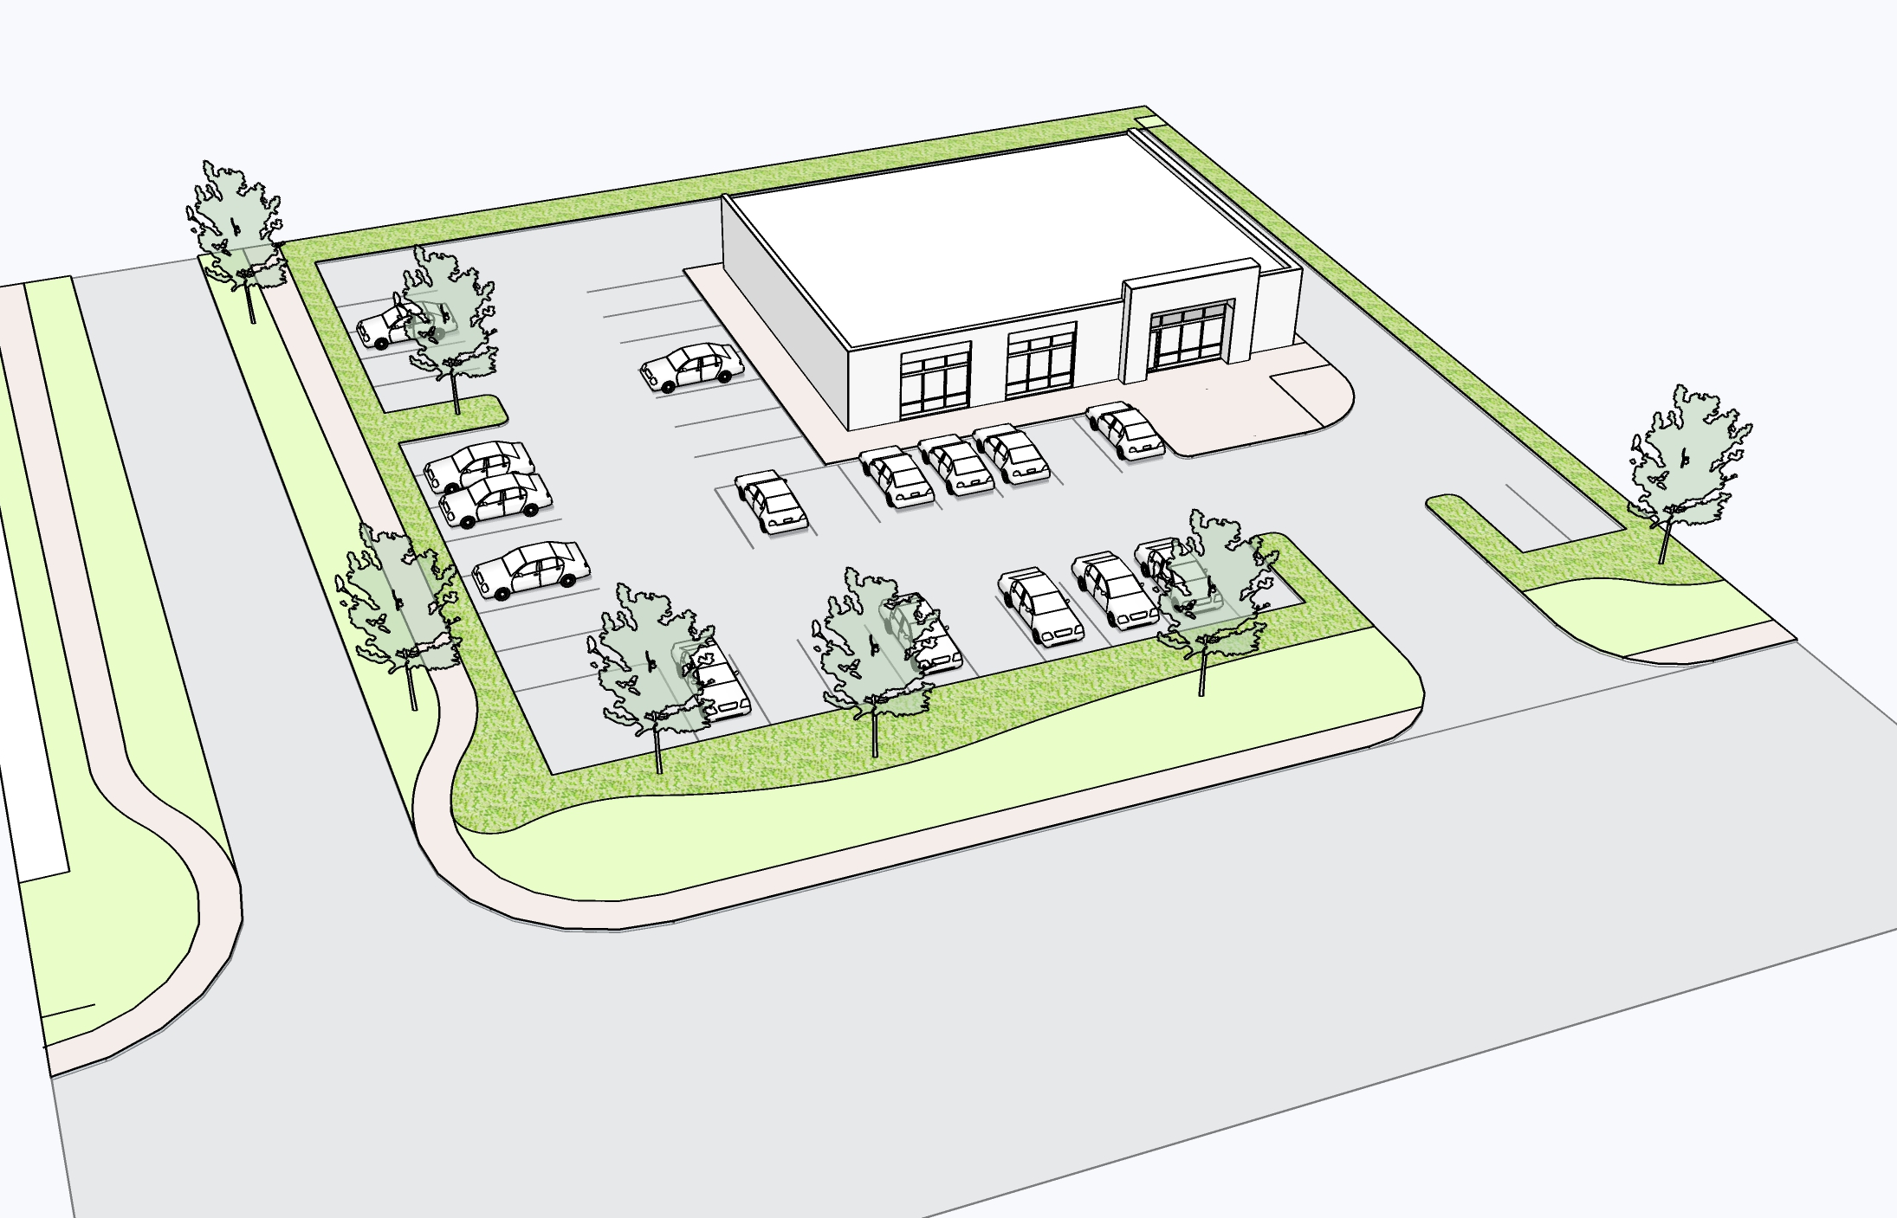
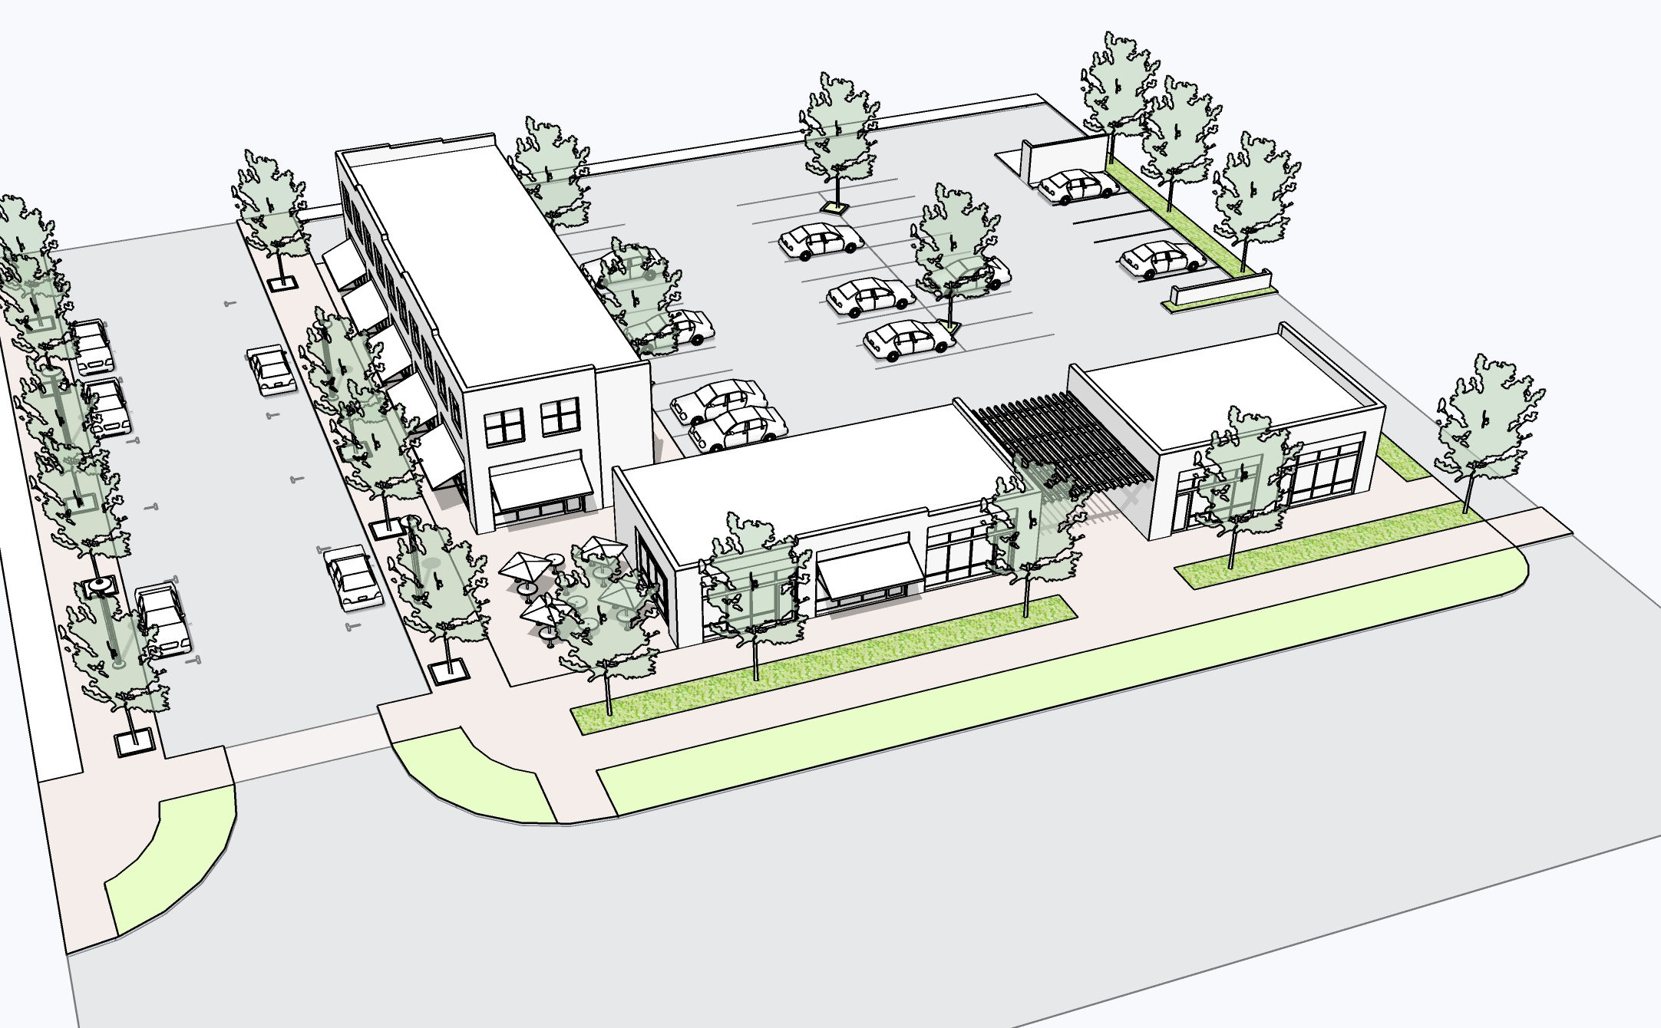
FUTURE ZONING CONSIDERATIONS
COMMUNITY INPUT WORKSHOP
A
More flexible use zones (limit higher intensity industrial uses)
New form-based zoning to address the different neighborhood and redevelopment contexts in the Animas Area
Focus on making it easy for missing-middle housing types to be developed
Develop more flexible development standards to apply to existing development to encourage redevelopment incrementally
Simplify and reduce parking standards (adopt blended ratios)
Adopt building design standards that complement street design standards to implement vision for walkable development
Administrative approvals for projects that meet the standards (depoliticize final approvals)
F A R M I N G T O N
B
O F
Image A illustrates the resulting site design permitted by the current zoning, with the building located at the rear and parking in front. To create a more walkable environment, buildings should be located closer to the sidewalk with parking in the rear as shown in image B. A Form-Based Code zoning approach (or overlay) can help to create a more walkable environment.
C I T Y

Slide 17
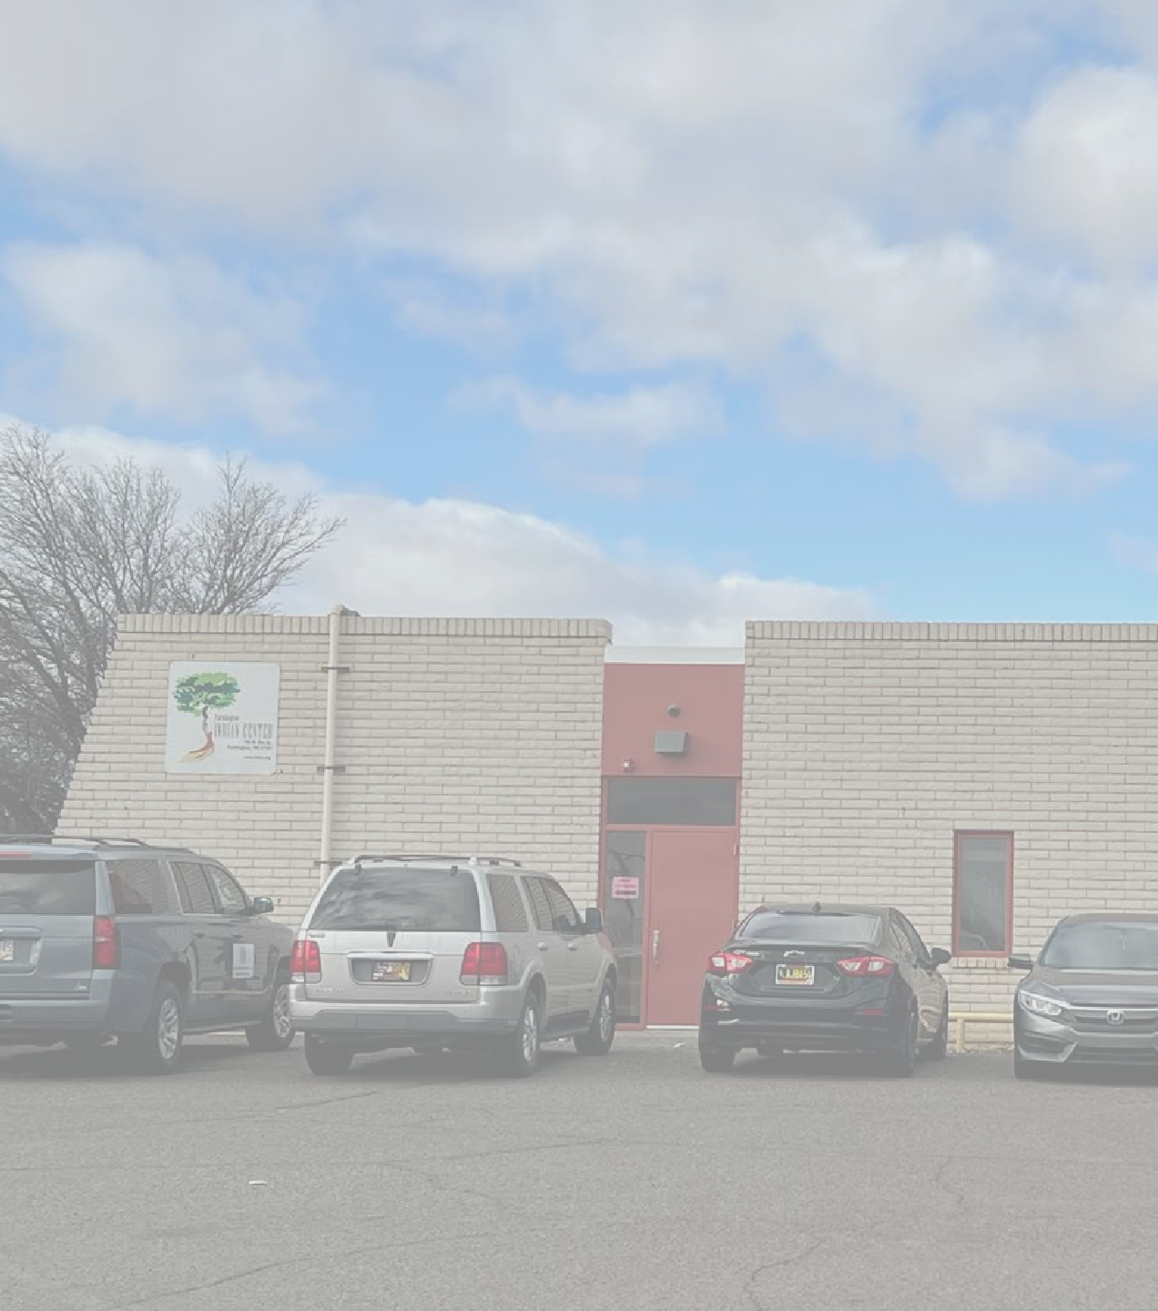
MARKET
COMMUNITY INPUT WORKSHOP
FEASIBILITY
C I T Y O F F A R M I N G T O N

Slide 18
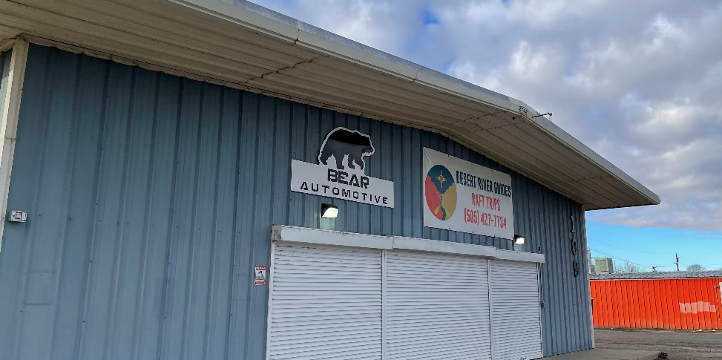
KEY CONSIDERATIONS
COMMUNITY INPUT WORKSHOP
The economic development challenges and opportunities identified in the Downtown MRA Plan (2019) are still relevant in 2023
Farmington’s population growth over the past decade has been modest – adding 500 to 1,000 residents
Within the Animas + Healthcare Hub area, population remains unchanged at 1,150 residents
Total employment within San Juan County has declined 10 percent since 2010
Within the Animas + Healthcare Hub area, Health Care & Social Assistance Sector employment represents over 68% employment
Total employment within the Animas + Healthcare Hub area 4,150 jobs
F A R M I N G T O N
O F
C I T Y

Slide 19
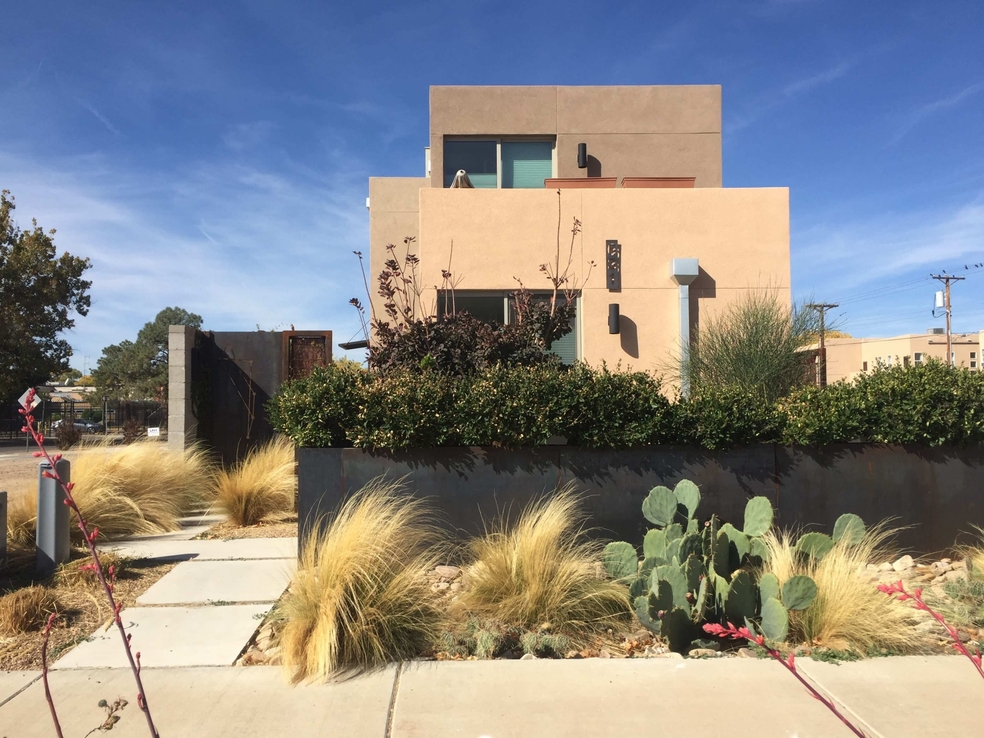
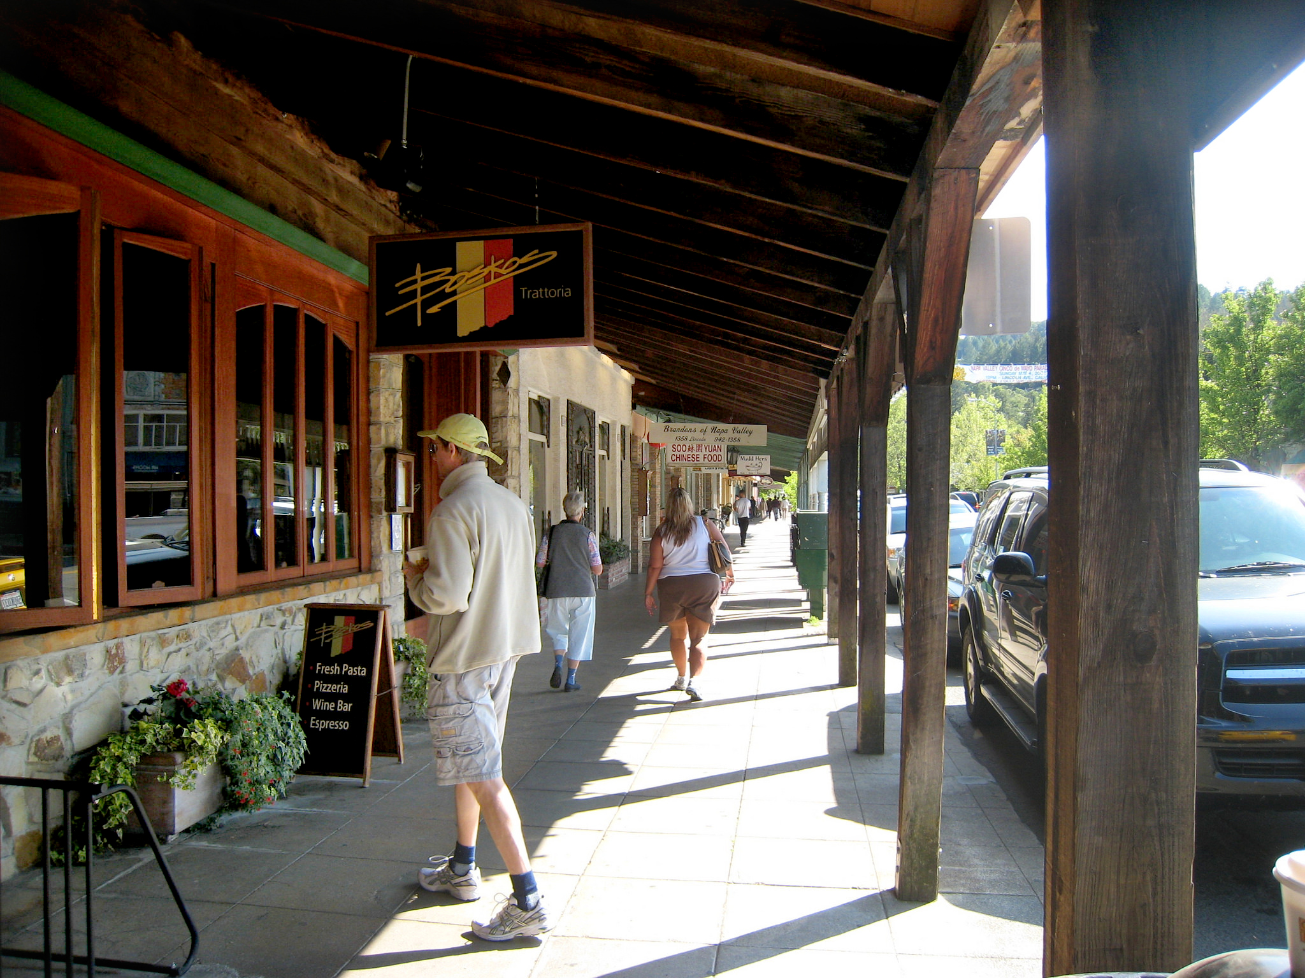
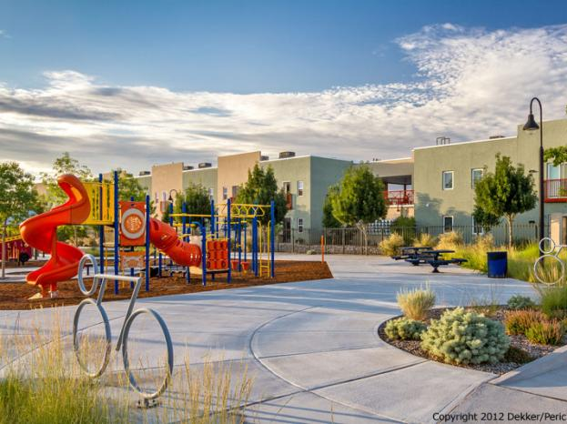
TABLE ACTIVITIES
COMMUNITY INPUT WORKSHOP
20 minutes total at each table (15 min. discussion, 5 min brief report out)
Housing
Economic Development
Parks, Recreation & Open Space
C I T Y O F F A R M I N G T O N

Slide 20
COMMUNITY INPUT WORKSHOP
NEXT STEPS
Attend the Final Open House:
Thursday, March 23 @ 5:30 PM
F A R M I N G T O N
2.
Take the Community Survey:
http://bit.ly/AnimasPlan
O F
3. Stay up-to-date at the project website: www.AnimasActionPlan.org
C I T Y

Slide 21
THANK YOU
WWW.ANIMASACTIONPLAN.ORG

Slide 22
Unused slides

Slide 23
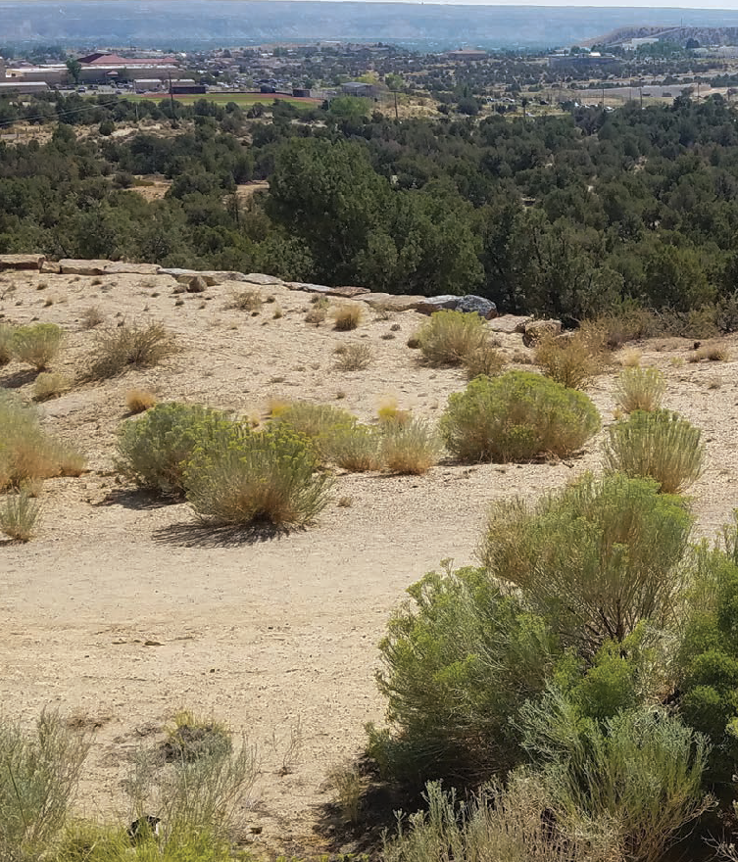
2021 COMPREHENSIVE PLAN
COMMUNITY INPUT WORKSHOP
Establishes the vision and blueprint for the future growth of Farmington
S AMPLE CAP TION
VISION
Farmington will support sustainable and innovative housing options, economic opportunities, and land uses that maintain Farmington as a safe and vibrant place.
F A R M I N G T O N
O F
N A V I G A T I N G
FARMINGTON’S FUTURE
C I T Y
COMPREHENSIVE PLAN
CITY OF FARMINGTON NEW MEXICO
ADOPTED SEPTEMBER 28, 2021

Slide 24
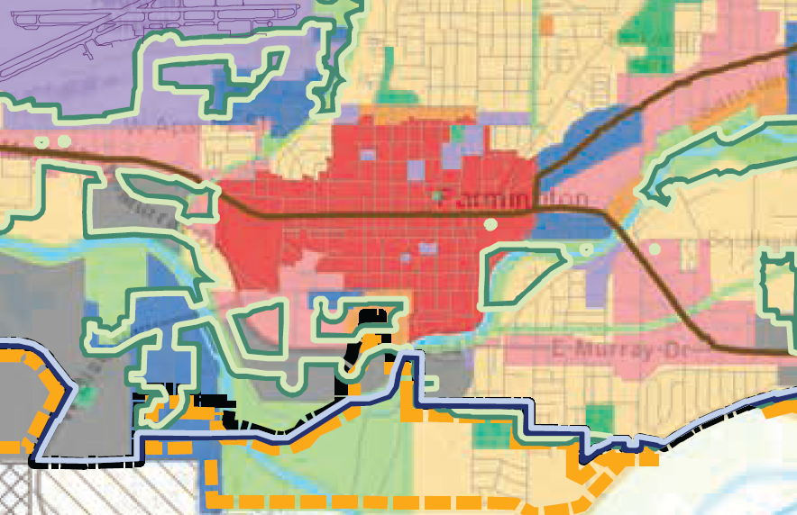
2021 COMPREHENSIVE PLAN
COMMUNITY INPUT WORKSHOP
Several goals and objectives relate to Downtown and the Animas Area
Downtown: Promote a vital community center incorporating a mix of uses, including retail, employment, light manufacturing, health services, housing, recreation, cultural, and neighborhood services.
S AMPLE CAP TION
F A R M I N G T O N
O F
C I T Y
Future Land Use Map for
the MRA
ADOPTED SEPTEMBER 28, 2021

Slide 25
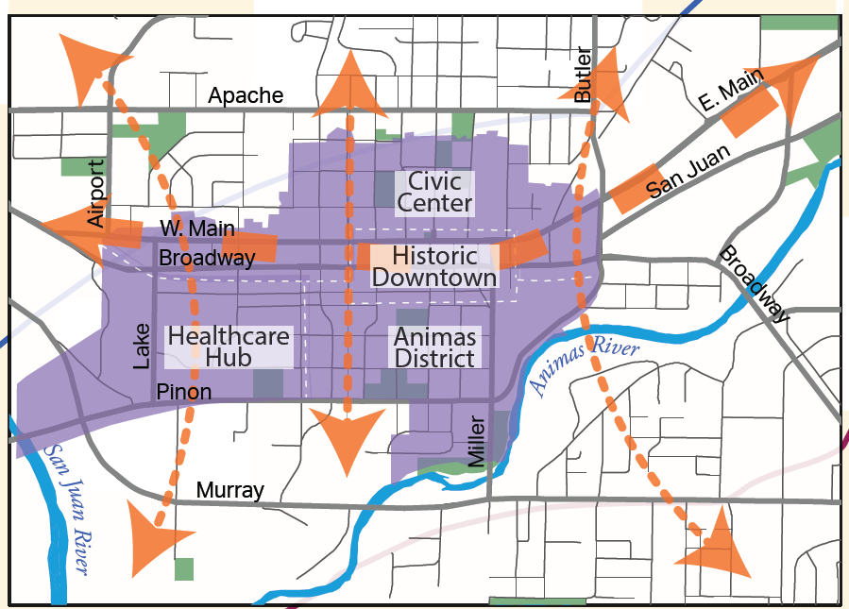
2021 COMPREHENSIVE PLAN
COMMUNITY INPUT WORKSHOP
S AMPLE CAP TION
F A R M I N G T O N
O F
C I T Y

Slide 26
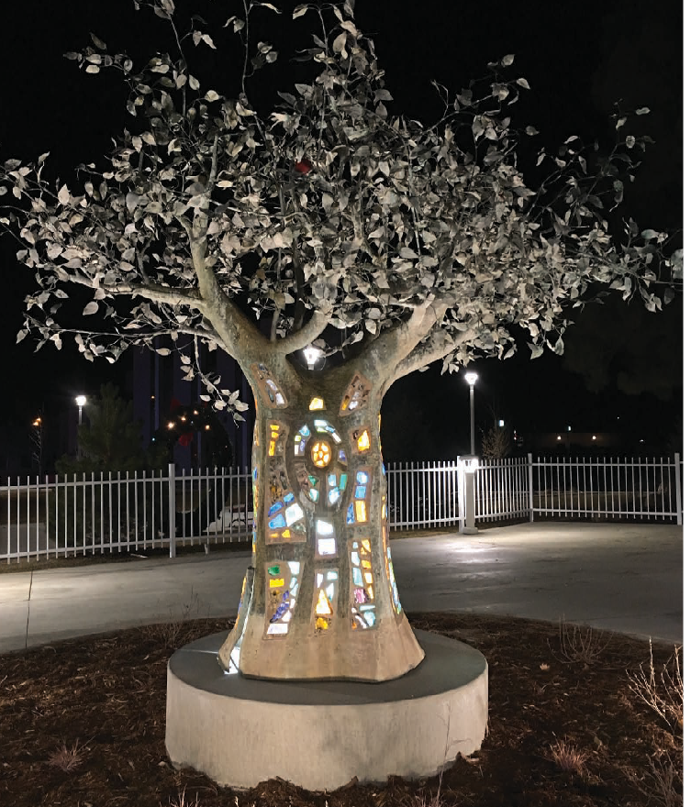
2019 MRA PLAN
COMMUNITY INPUT WORKSHOP
TOOLS OF THE MRA
The MRA Plan report identifies the tools available for promoting economic development, including:
Entering into public-private partnerships, such as a development agreement
Funding projects through revenue bonds
Acquiring funding through Community Development Block Grants (CDBG) and other state and federal sources
Implementing tax increment financing (TIF) (implemented in Farmington in 2018) and tax increment development districts (TIDD)
Employing the Local Economic Development Act (LEDA)
S AMPLE CAP TION
FARMINGTON, NM
DOWNTOWN
MRA PLAN
2 0 1 9 U P D A T E

Slide 27
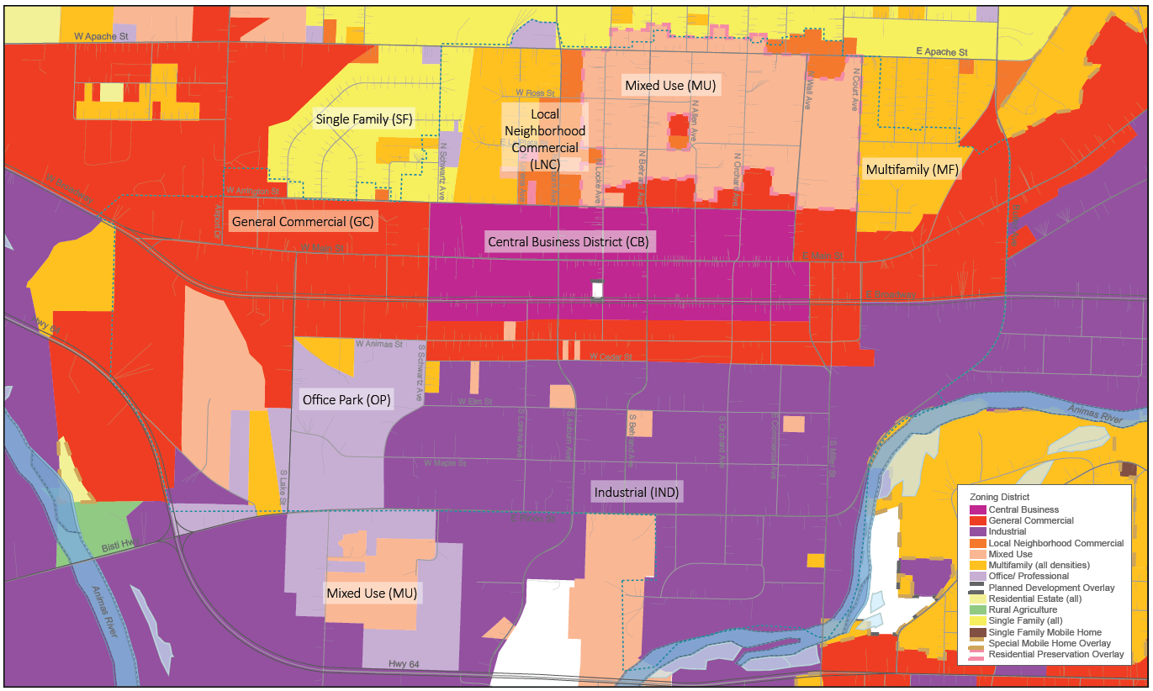
MRA PLAN
COMMUNITY INPUT WORKSHOP
ZONING
The MRA Plan makes the following recommendations regarding the existing zoning within the districts:
Rezone land in the Animas Area to establish adjacent areas of MU and IND zones as appropriate
Revise the allowable uses in city zoning to permit more uses in the MU and IND zones
Create a special zoning overlay in the MRA or in the Animas Area to permit desired uses
Establish a “Neighborhood Industrial” zoning category to allow light industry in a mixed-use setting
Implement performance-based zoning in the Animas Area [for example, reduce required setbacks to establish a connection with the sidewalk]

Slide 28
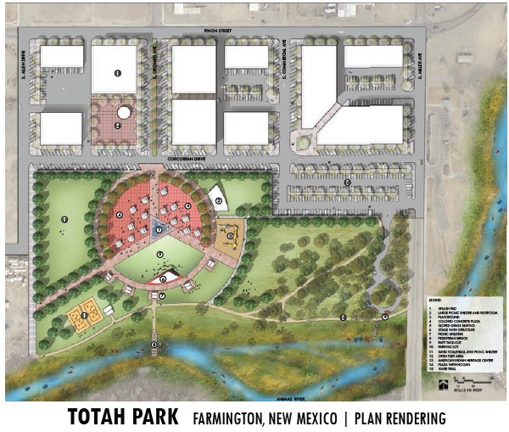
MRA PLAN
COMMUNITY INPUT WORKSHOP
ANIMAS AREA STRATEGIES
The MRA Plan identified several clear strategies to implement the vision for the Animas Area:
Revise the zoning codes to reflect the community vision [this is a "low hanging fruit" which should be prioritized]
Develop and improve the parks, trails, and access to the Animas River on the south edge of the MRA. "Fund and build Totah Park"
Connect the proposed Totah Park to the Historic Downtown.
OTHER KEY FINDINGS:
Continue to support the Outdoor Recreation Industry Initiative (ORII) to complement the region's existing energy industry.
Create a community food hub and promote local food production
This concept plan was developed for the proposed Totah Park. New flood maps indicate that nearly all of the area is in a floodway. Many of the outdoor programmatic elements of the plan may still be suitable for the site, but the number and scale of the buildings may be too intensive for the floodway.

Slide 29
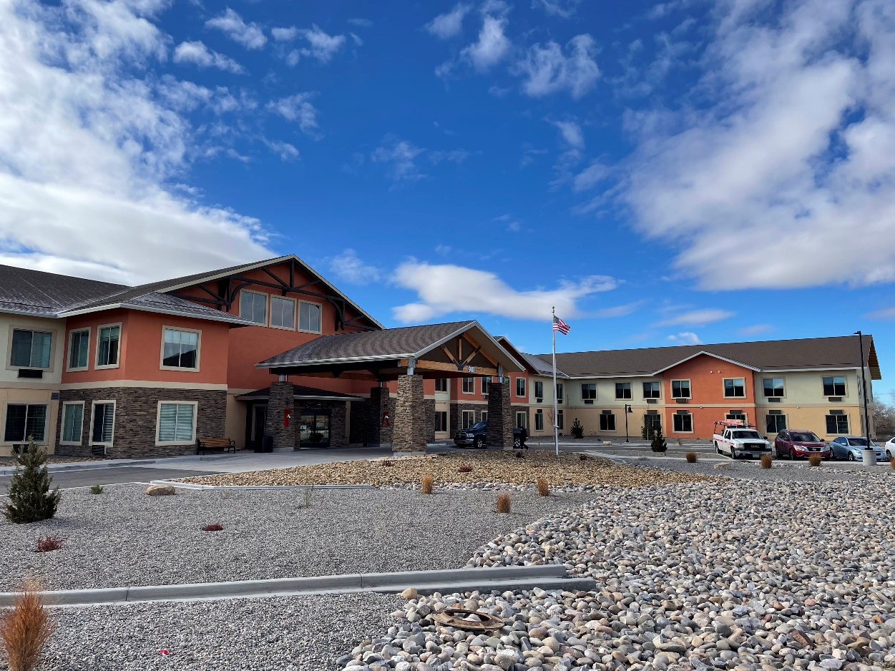
MRA PLAN
COMMUNITY INPUT WORKSHOP
HEALTHCARE HUB STRATEGIES
The MRA Plan identified several clear strategies to implement the vision for the Healthcare Hub:
Collaborate with the SJRMC and SJRMC Foundation to continue improving the neighborhood
Redevelop the block north of Animas to Broadway for medical related uses
Support the rehabilitation or redevelopment of older deteriorated housing in the Healthcare Hub
Encourage the development of additional multifamily and senior housing in the western edge of the Healthcare Hub [much of this has been accomplished]

Slide 30
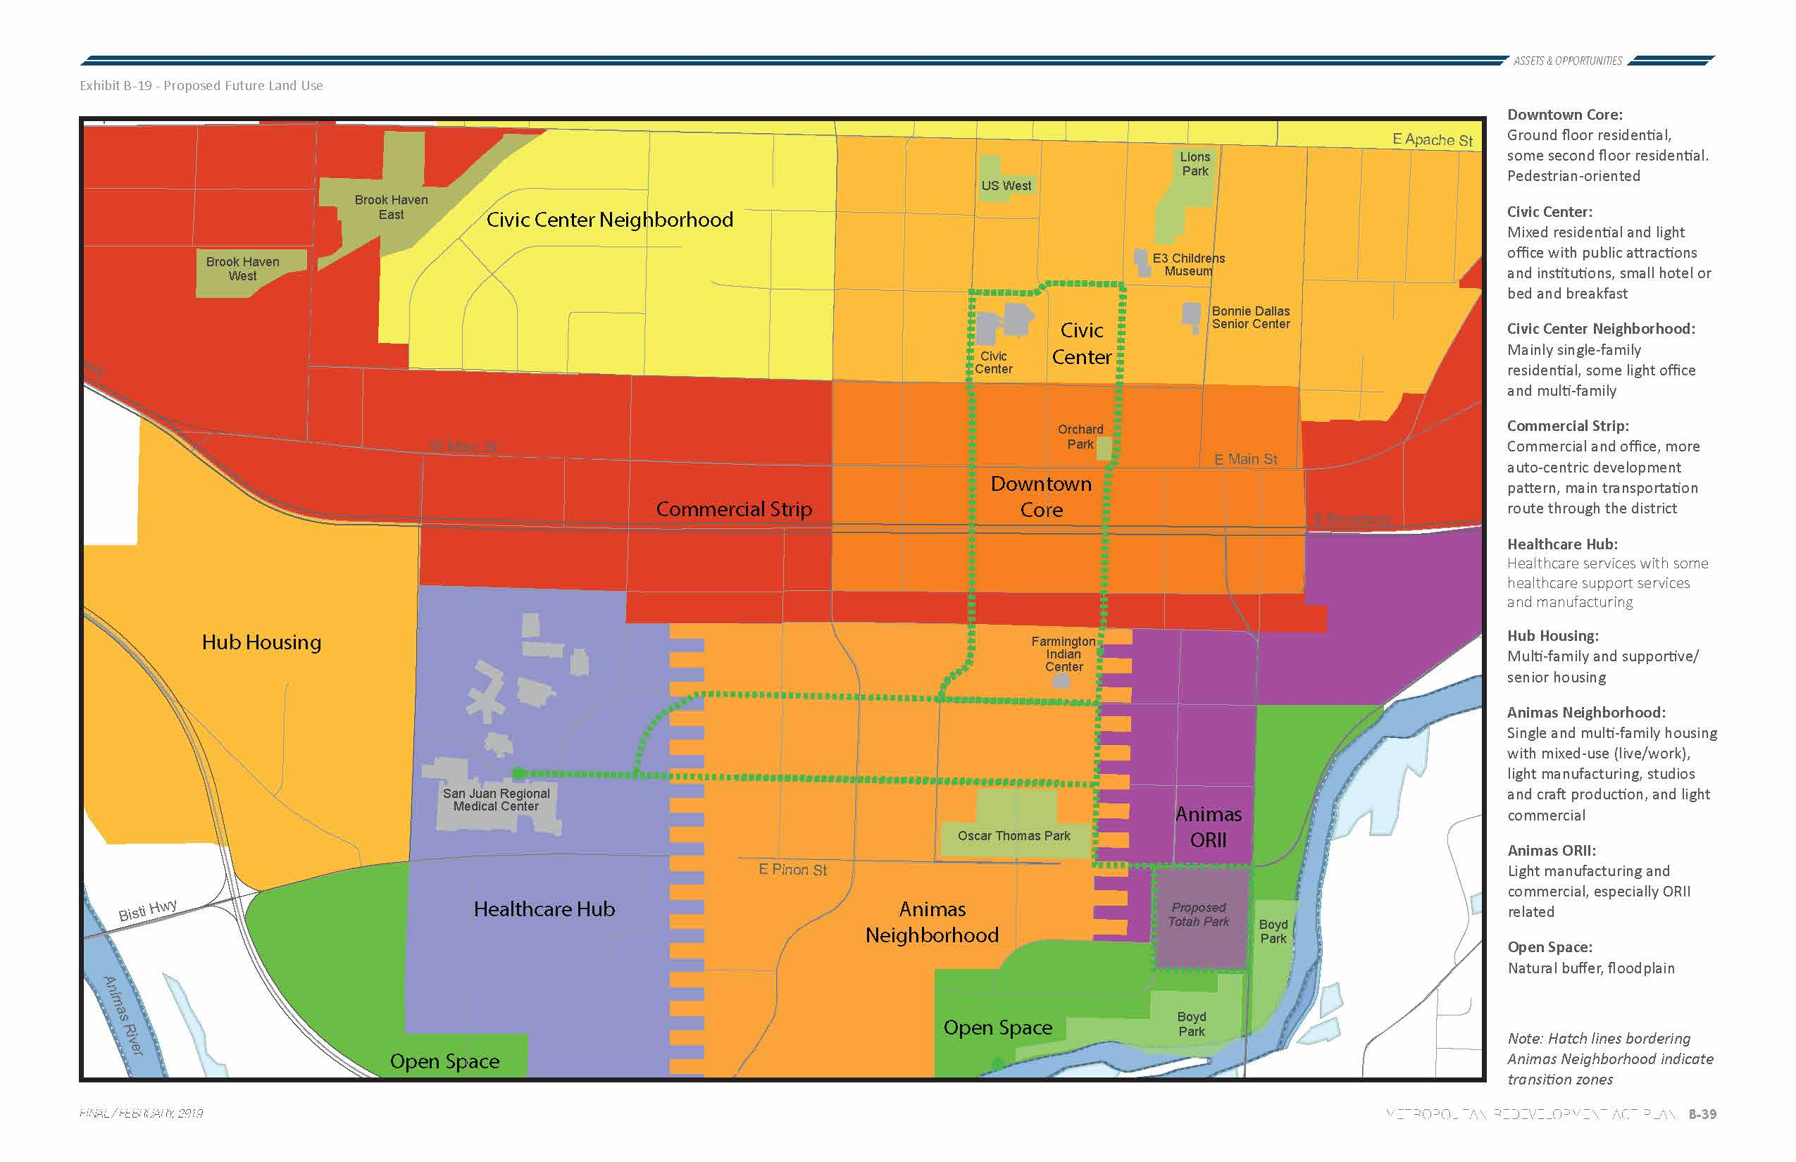
MRA PLAN
COMMUNITY INPUT WORKSHOP
Proposed Future Land Use Map

Slide 31
MRA PLAN
Orchard Ave
Auburn Ave
Behrand Ave
Miller St
Animas St
The MRA Plan includes a "Future Trails and Pathways Priority Routes" plan which identifies existing and proposed multi-modal paths to connect at the local, metro and regional scales.
Elm St
Maple St

Slide 32
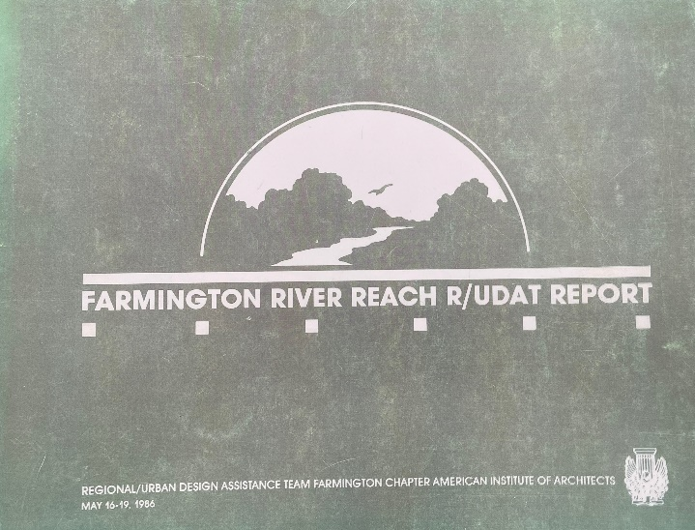
RIVER REACH REPORTS
COMMUNITY INPUT WORKSHOP
Farmington River Reach R/UDAT Report (1986)
Developed by the River Reach and Regional Urban Design Assistance Team
Outlines 5 topics: 1) Protection of existing resources, 2) Riverine management, 3) Development of existing parks, 4) Achievable opportunities, and 5) Economic potentials for private lands
Recommends a “Continuum of Appropriate Land Uses”
Preservation →
Agricultural/Open Spaces →
Outdoor Recreation →
River-Oriented Commercial Uses
Totah Festival Market/Hotel Riverfront Commercial Area & Confluence Park imagined just east and west of project area, respectively
F A R M I N G T O N
O F
C I T Y

Slide 33
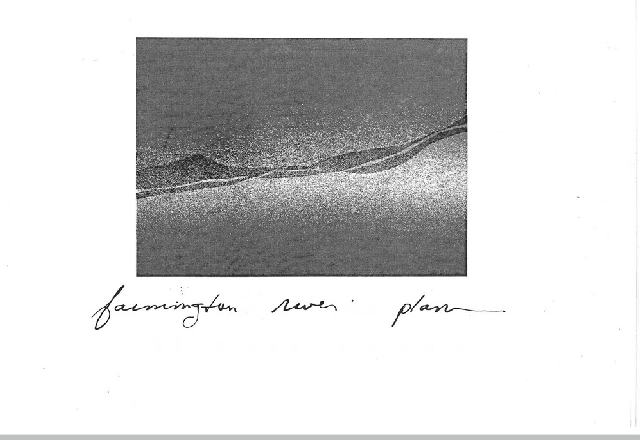
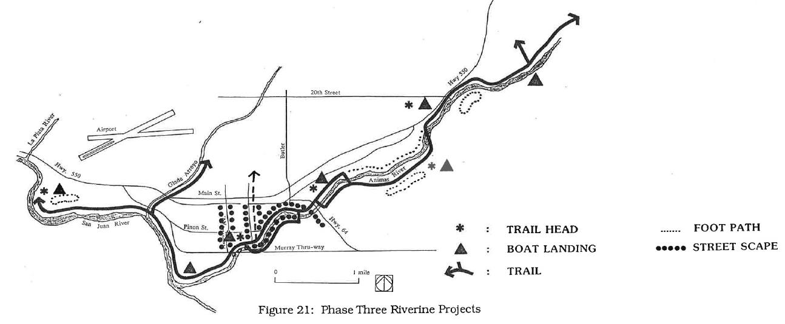
RIVER REACH REPORTS
COMMUNITY INPUT WORKSHOP
Farmington’s Riverine Corridor Plan (1990)
Purpose is to “set a direction of the use and development of Farmington’s Riverine Corridor…and to guide the city in expending GRT dedicated to the corridor”
Key issues identified:
- Stewardship of the Riverine Corridor – Who will advocate for and maintain the corridor?
- Recreational Use of the Corridor – What types of activities and improvements should be developed?
- Urban Design – How can the corridor become a distinctive, visible, accessible attraction?
The Lower Downtown Riverfront area encompasses this project area; recommended amenities include: trails, kayak run, boat landing, picnic shelter, natural amphitheater, nature center, streetscape improvements along Orchard St.
F A R M I N G T O N
O F
C I T Y

Slide 34
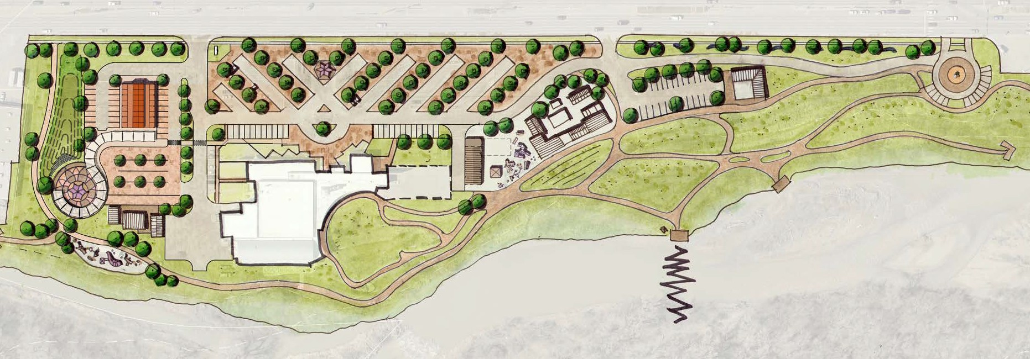
TRAIL PROJECTS
COMMUNITY INPUT WORKSHOP
Animas River Trail – Northern Extension
Westland Park Trail Connection
Lower Animas Valley Recreational Trail
Whitewater Feasibility Study-Animas and San Juan Rivers
F A R M I N G T O N
O F
C I T Y

Slide 35
OBSERVATIONS
COMMUNITY INPUT WORKSHOP
//0 7
F A R M I N G T O N
//08
O F
C I T Y
//09

Slide 36
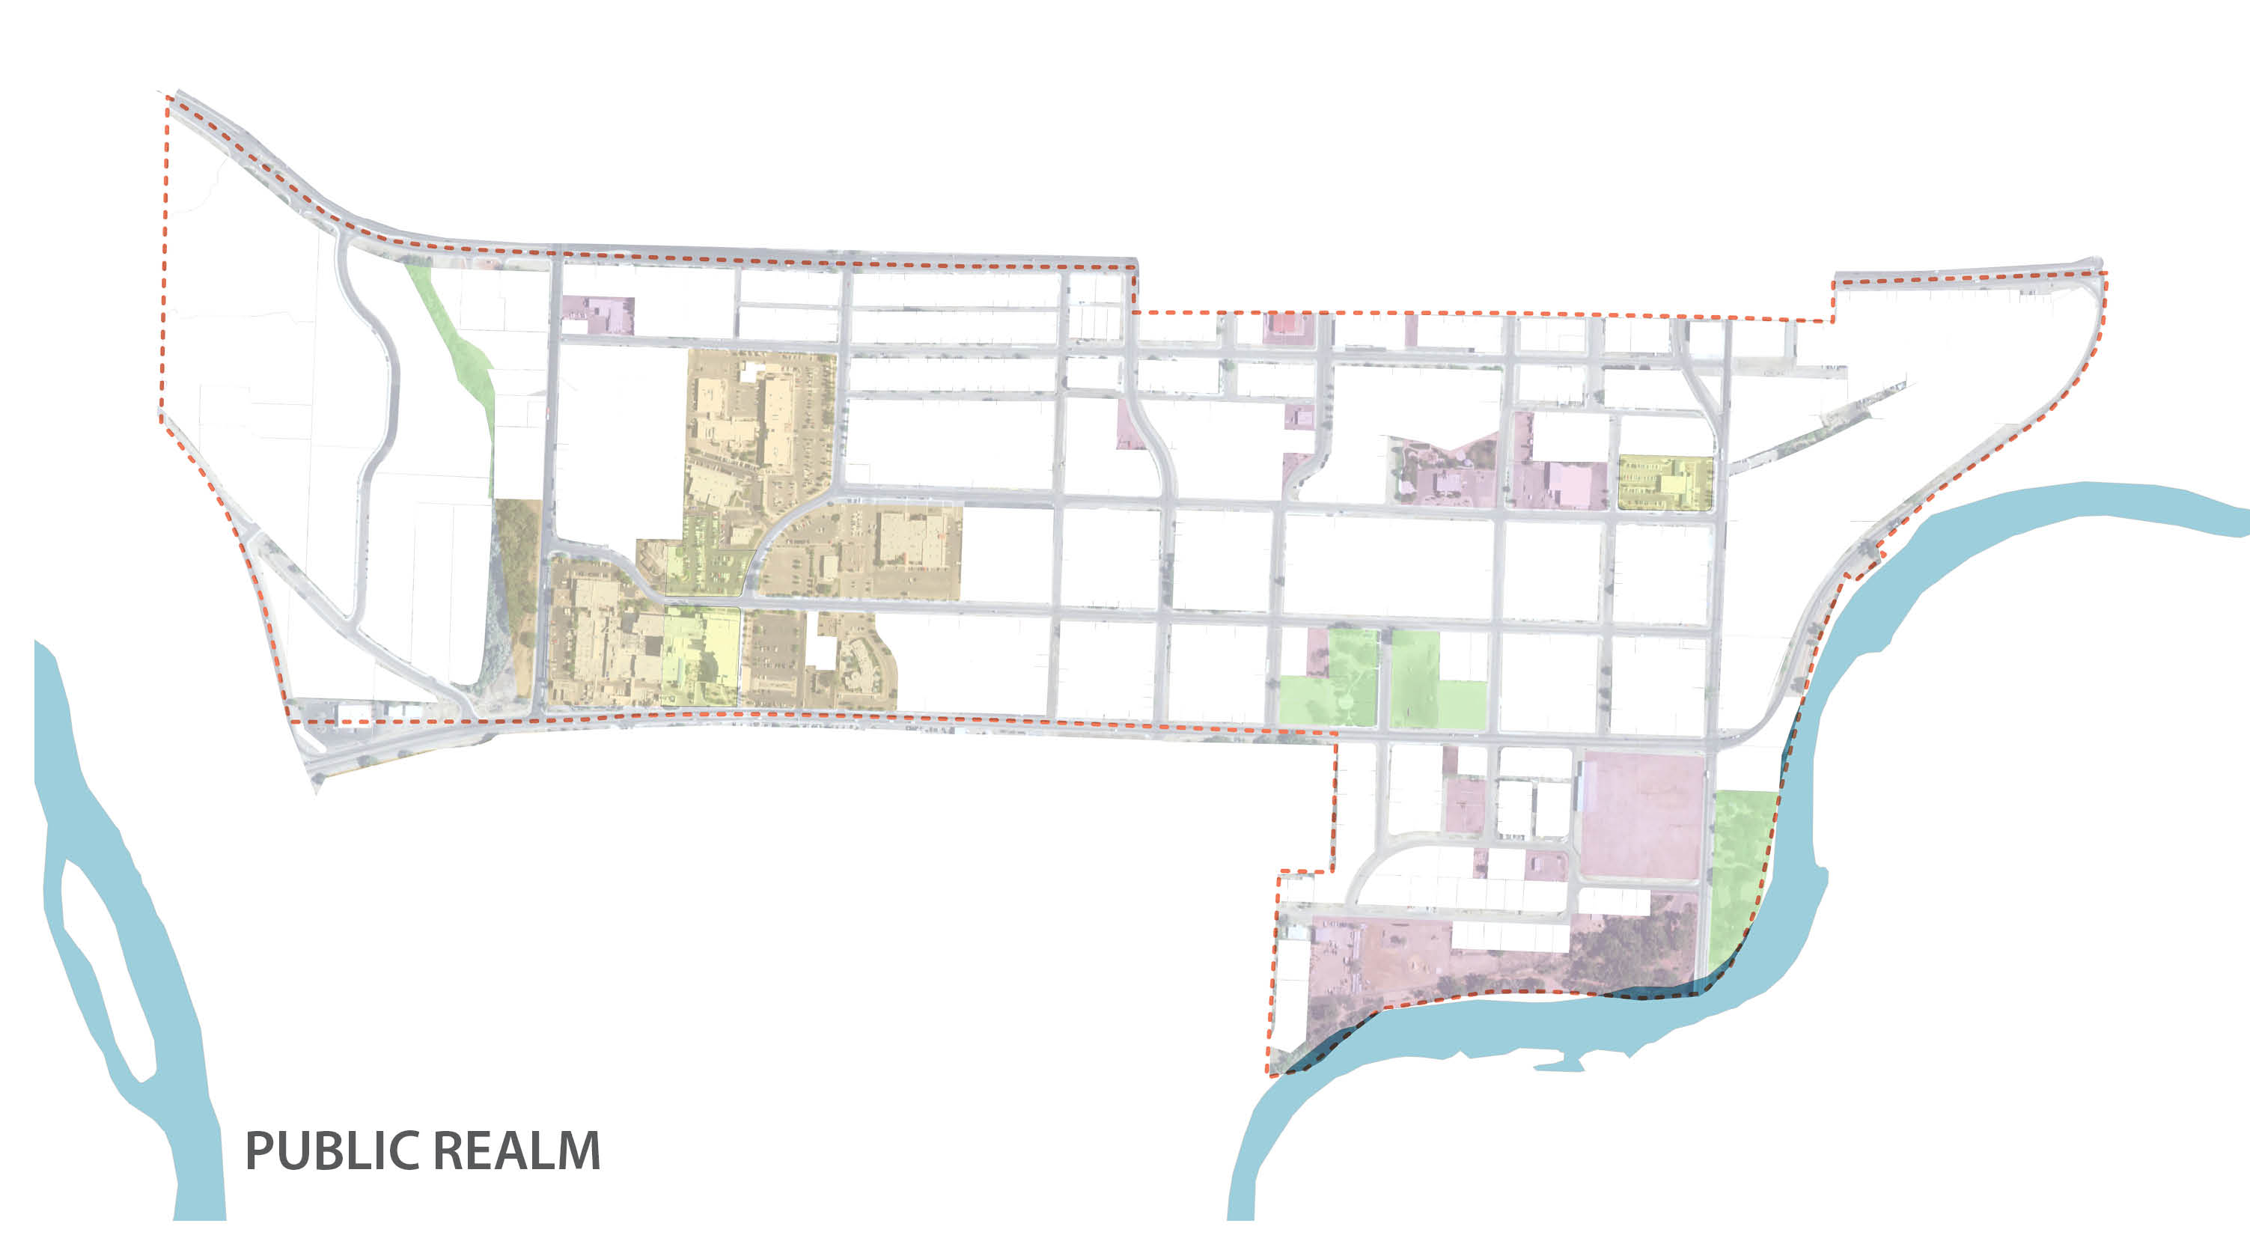
PUBLIC REALM ANALYSIS
COMMUNITY INPUT WORKSHOP
PUBLIC REALM
The Public Realm consists of the publicly owned and maintained land and institutions that provide the civic framework for the community. The public realm includes streets, parks, libraries, hospitals and other public services. A high-quality public enhances quality of life and adds value to the private realm.
In the case of the Animas Area, there is a strong network of public institutions including the San Juan Regional Medical Center and other social services. In addition, there are two existing parks which provide residents with outdoor recreation.
The street network which connects these services and amenities, and which is also part of the public realm, exhibits good block structure which facilitates connectivity. However, the condition of the streets is of marginal quality, primarily due to its history as a local industrial center.
F A R M I N G T O N
O F
C I T Y

Slide 37
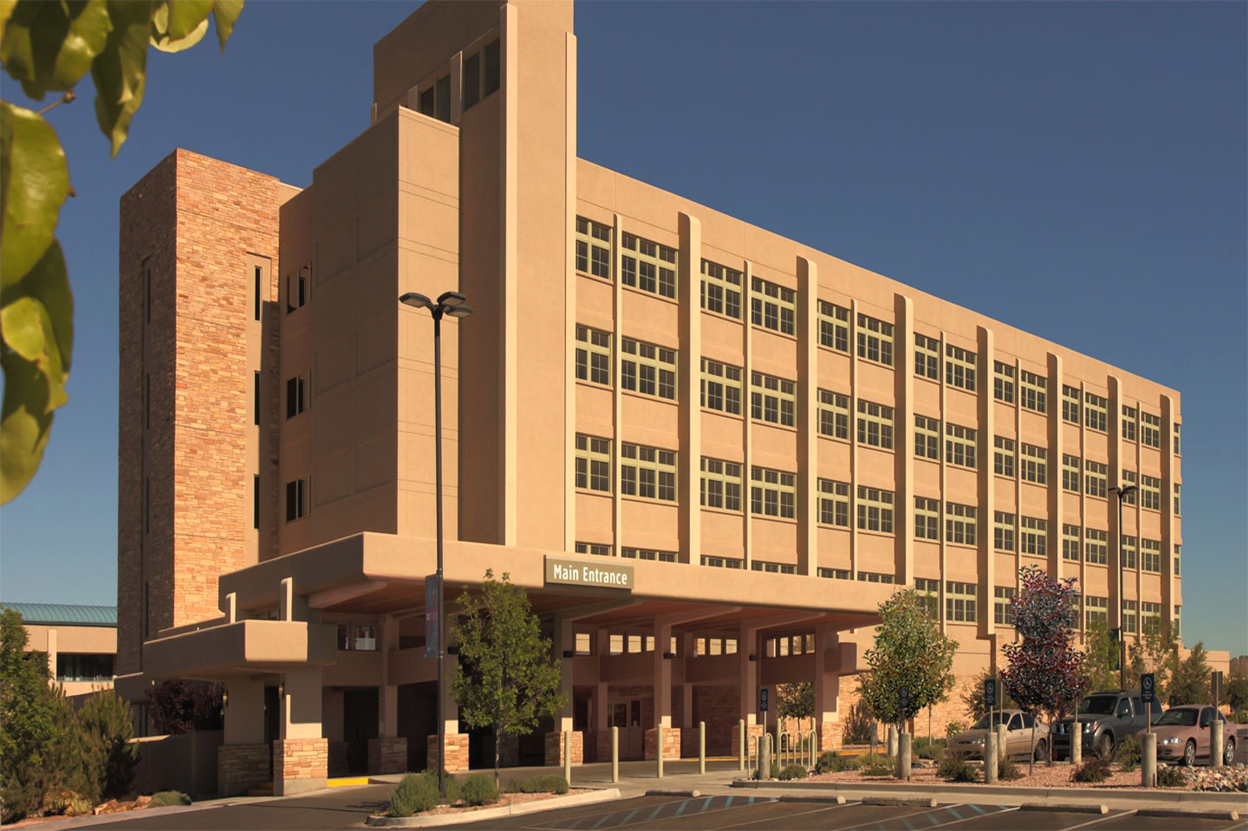
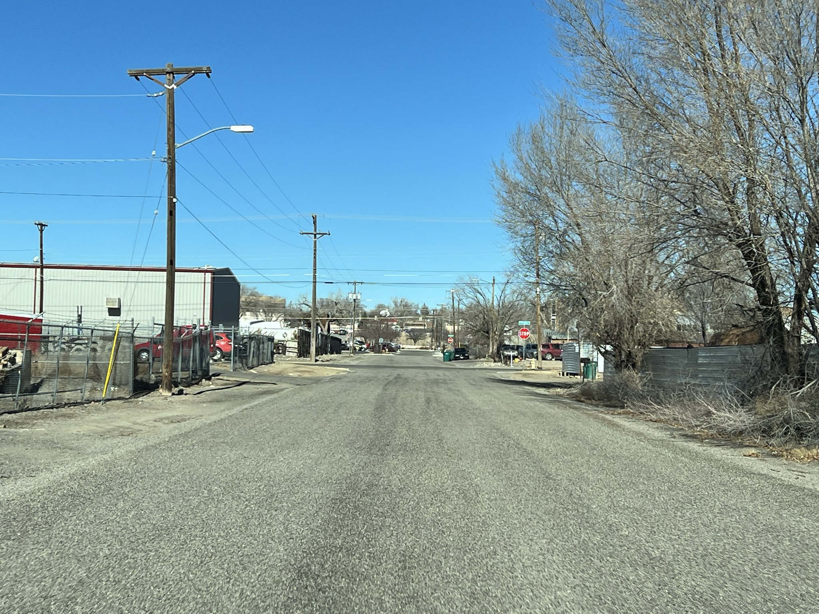
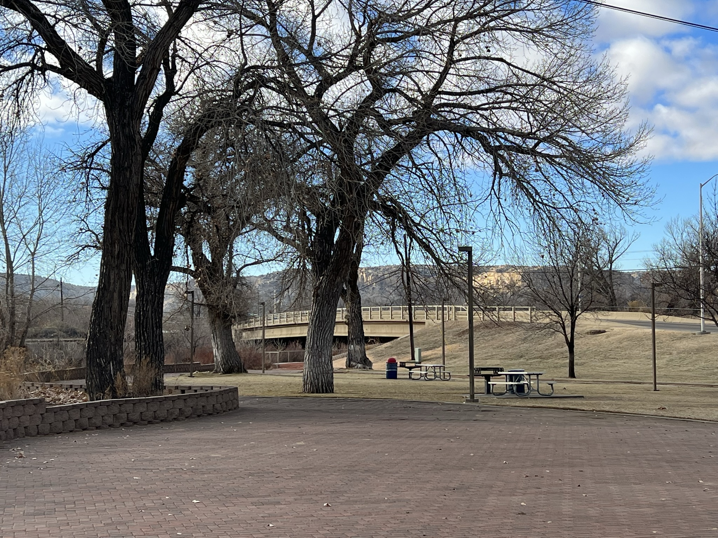
PUBLIC REALM ANALYSIS
COMMUNITY INPUT WORKSHOP
C O N D I T I O N S
F A R M I N G T O N
O F
C I T Y

Slide 38
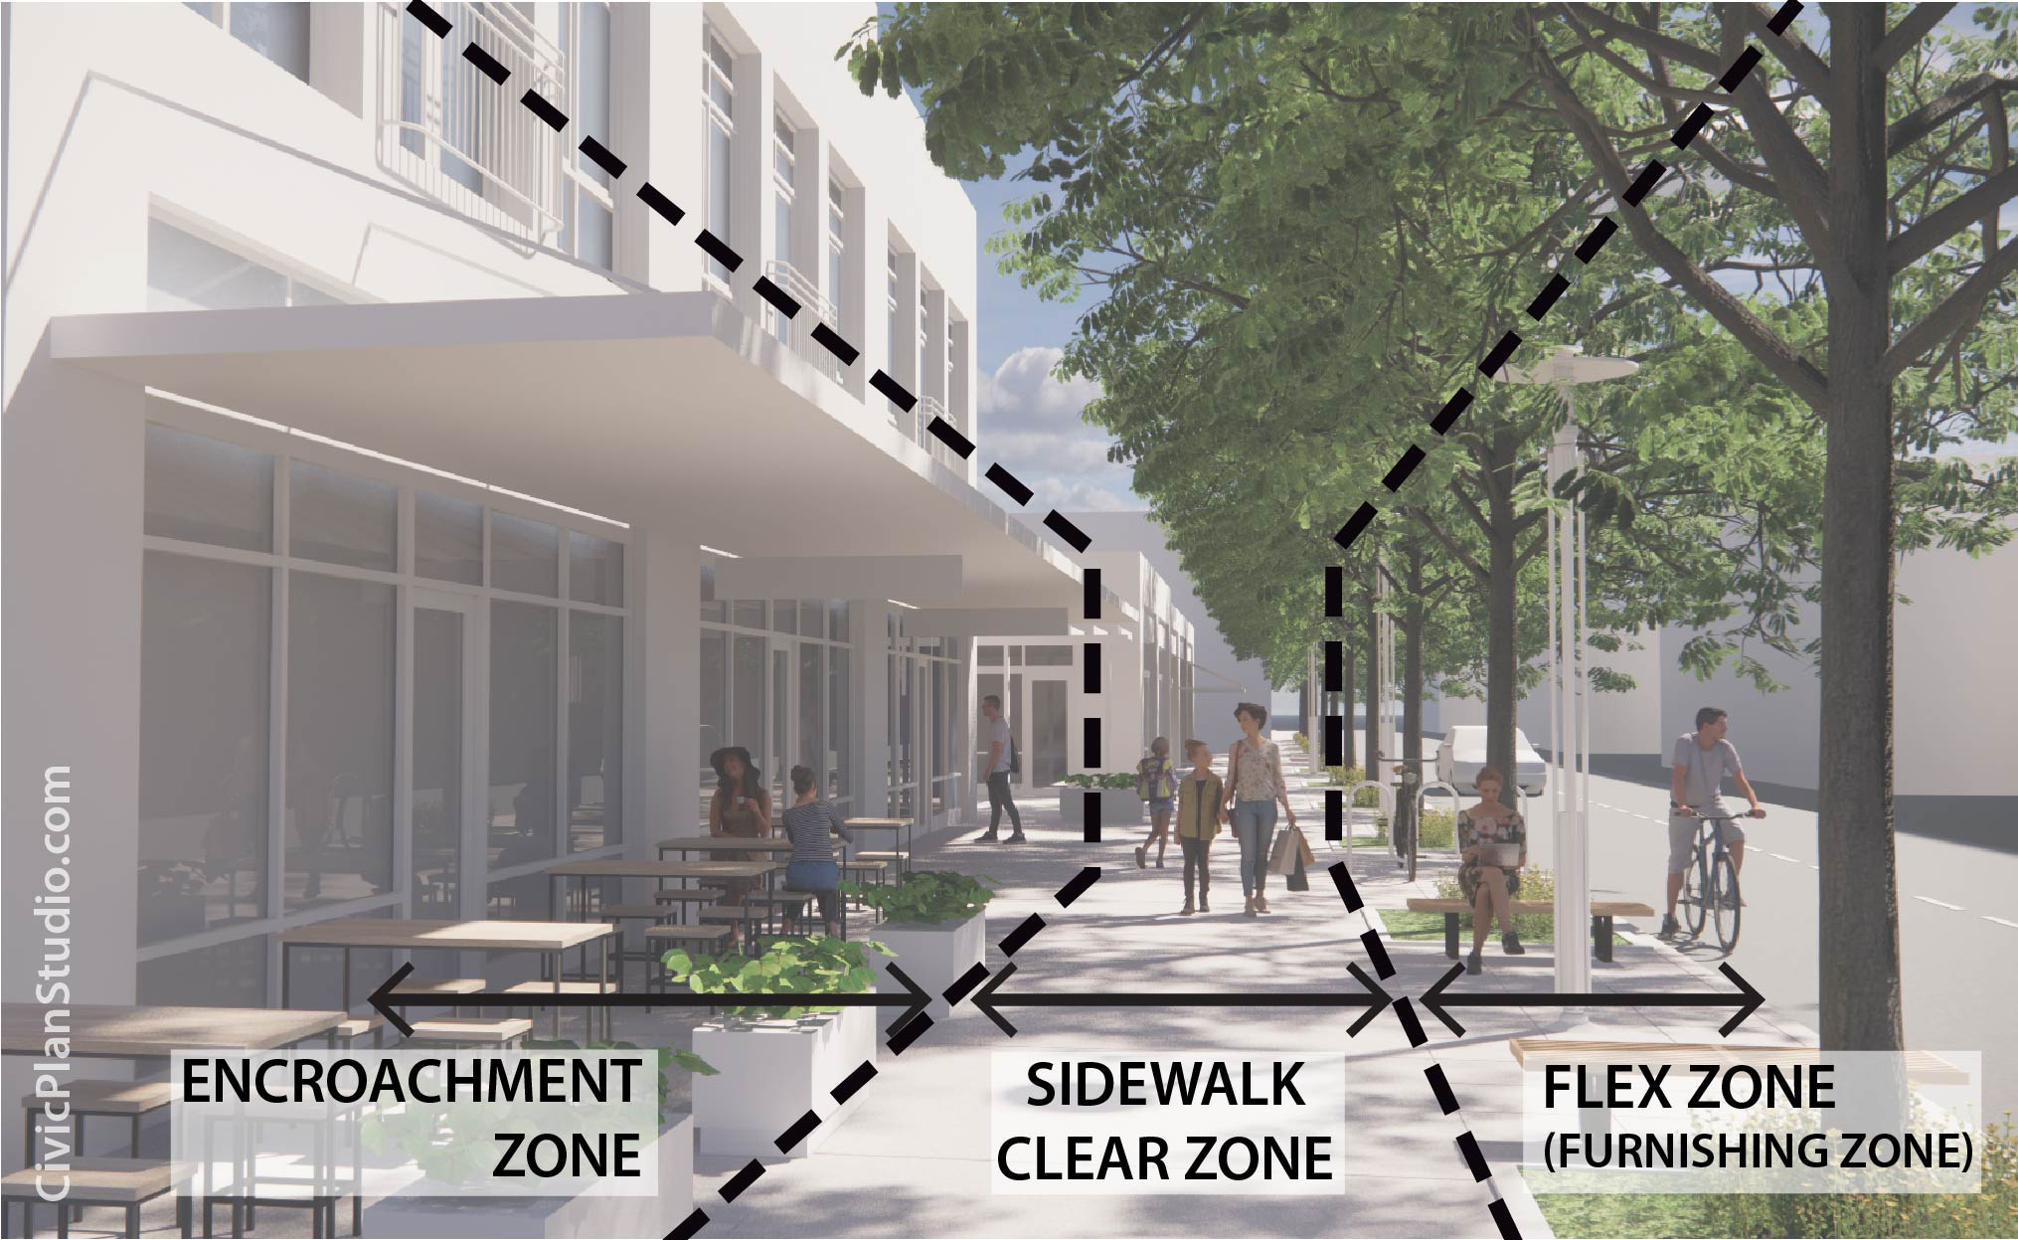
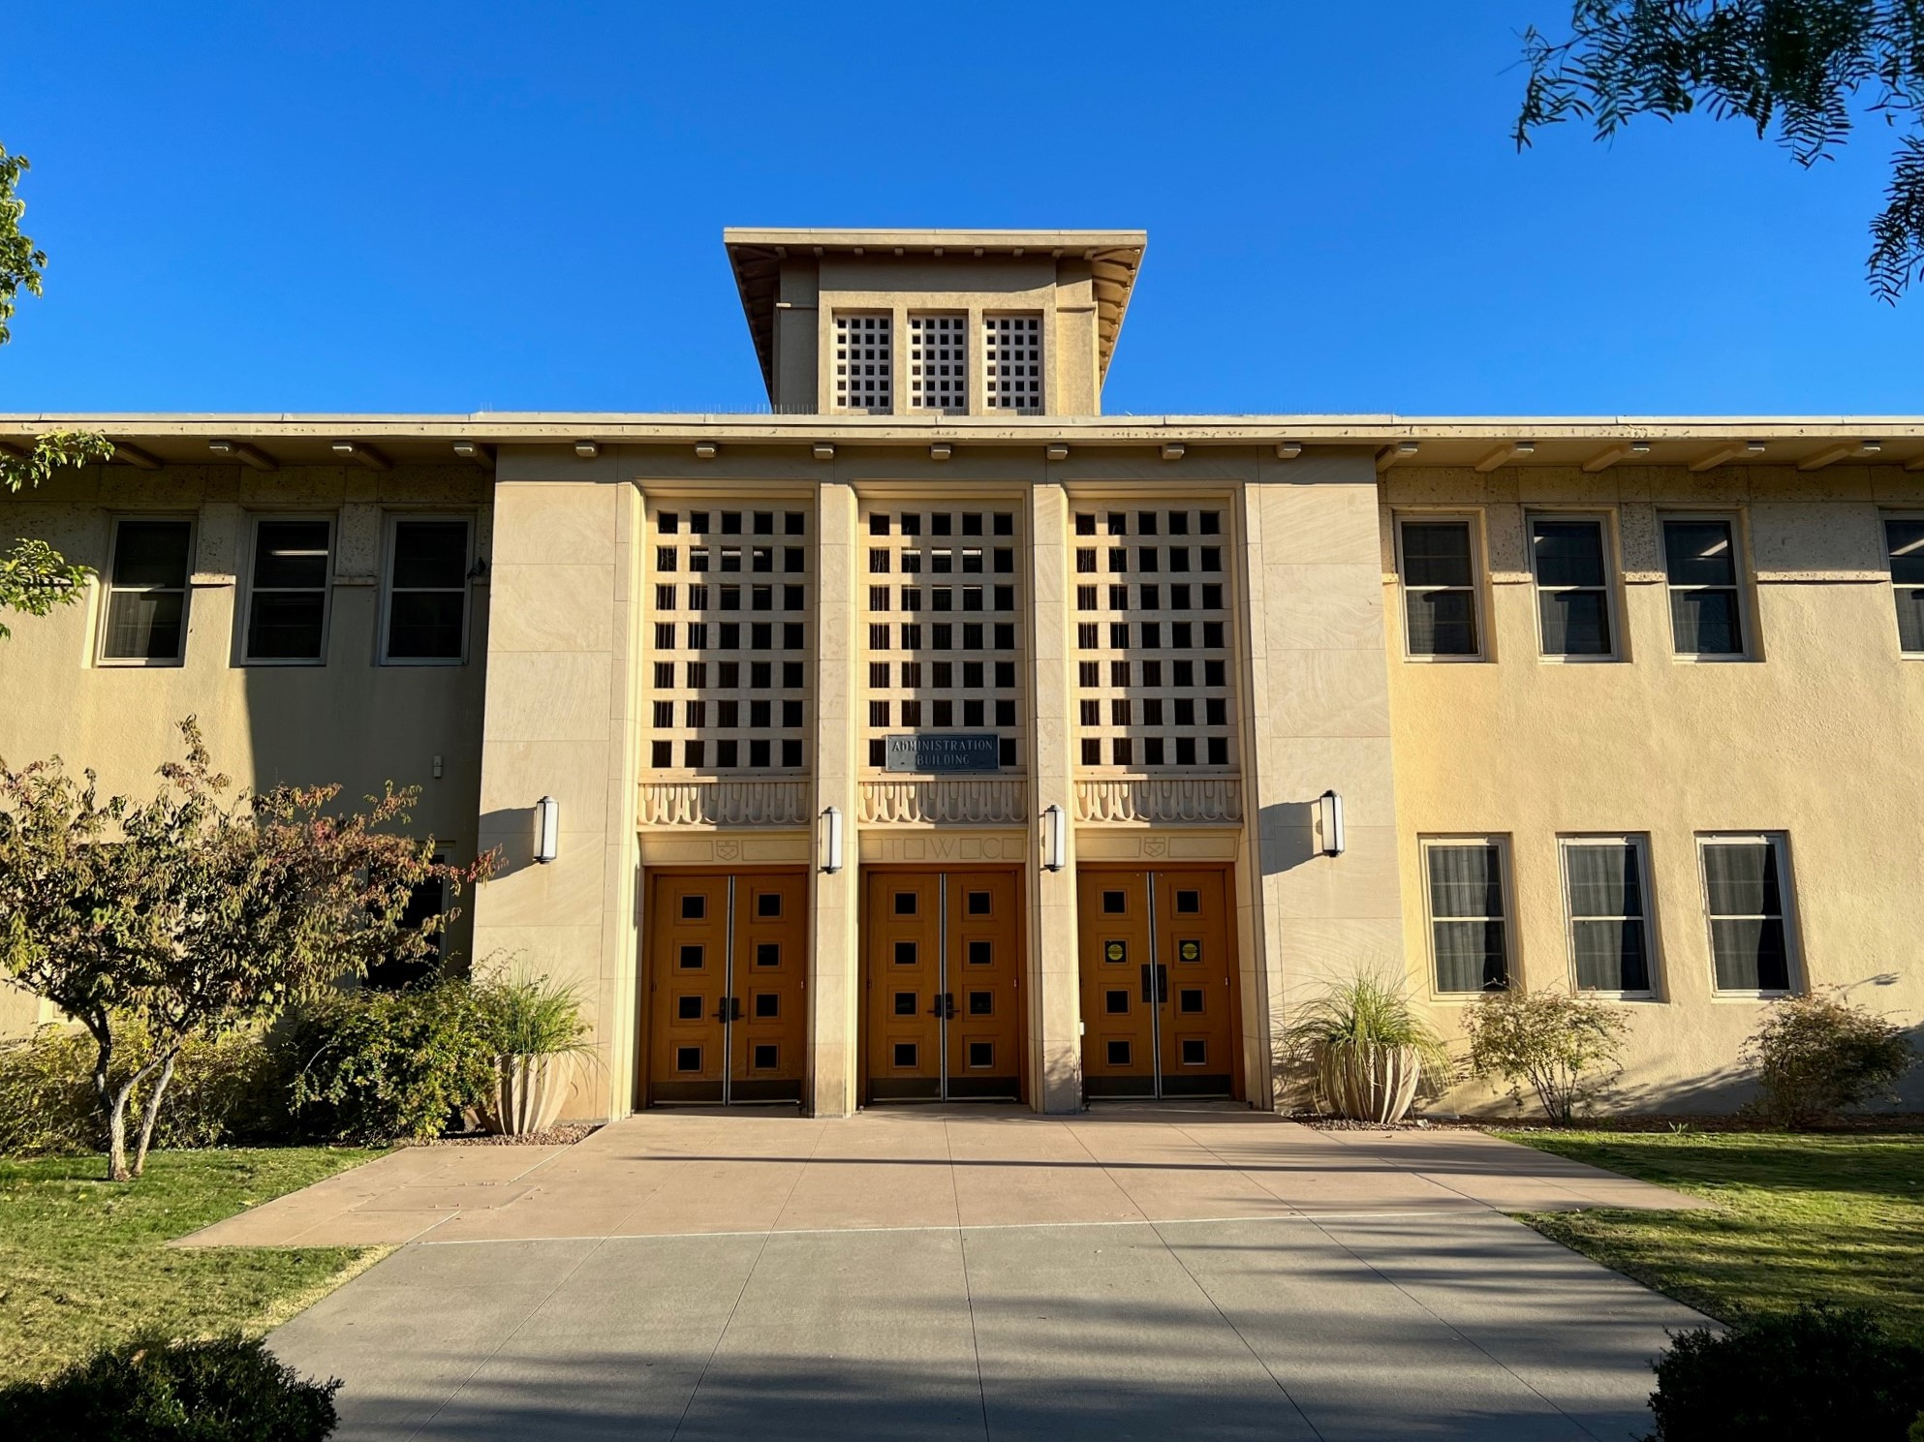
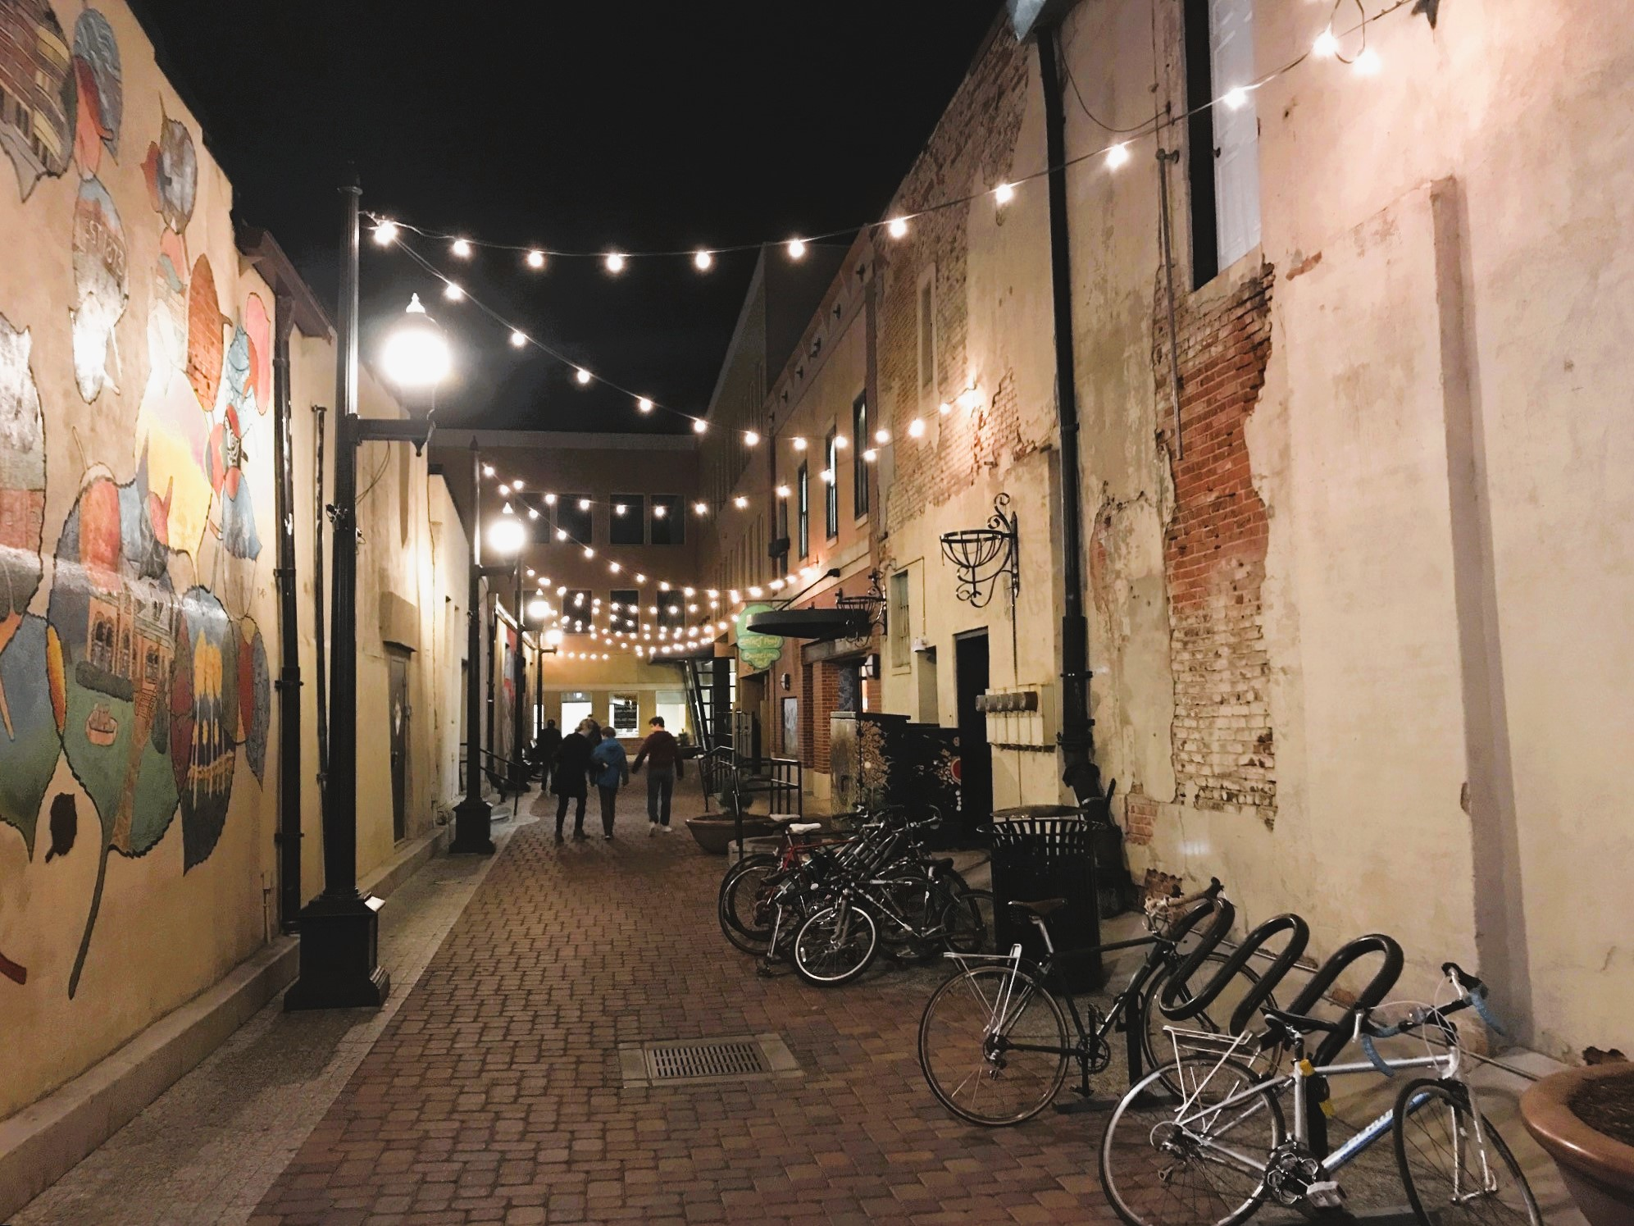
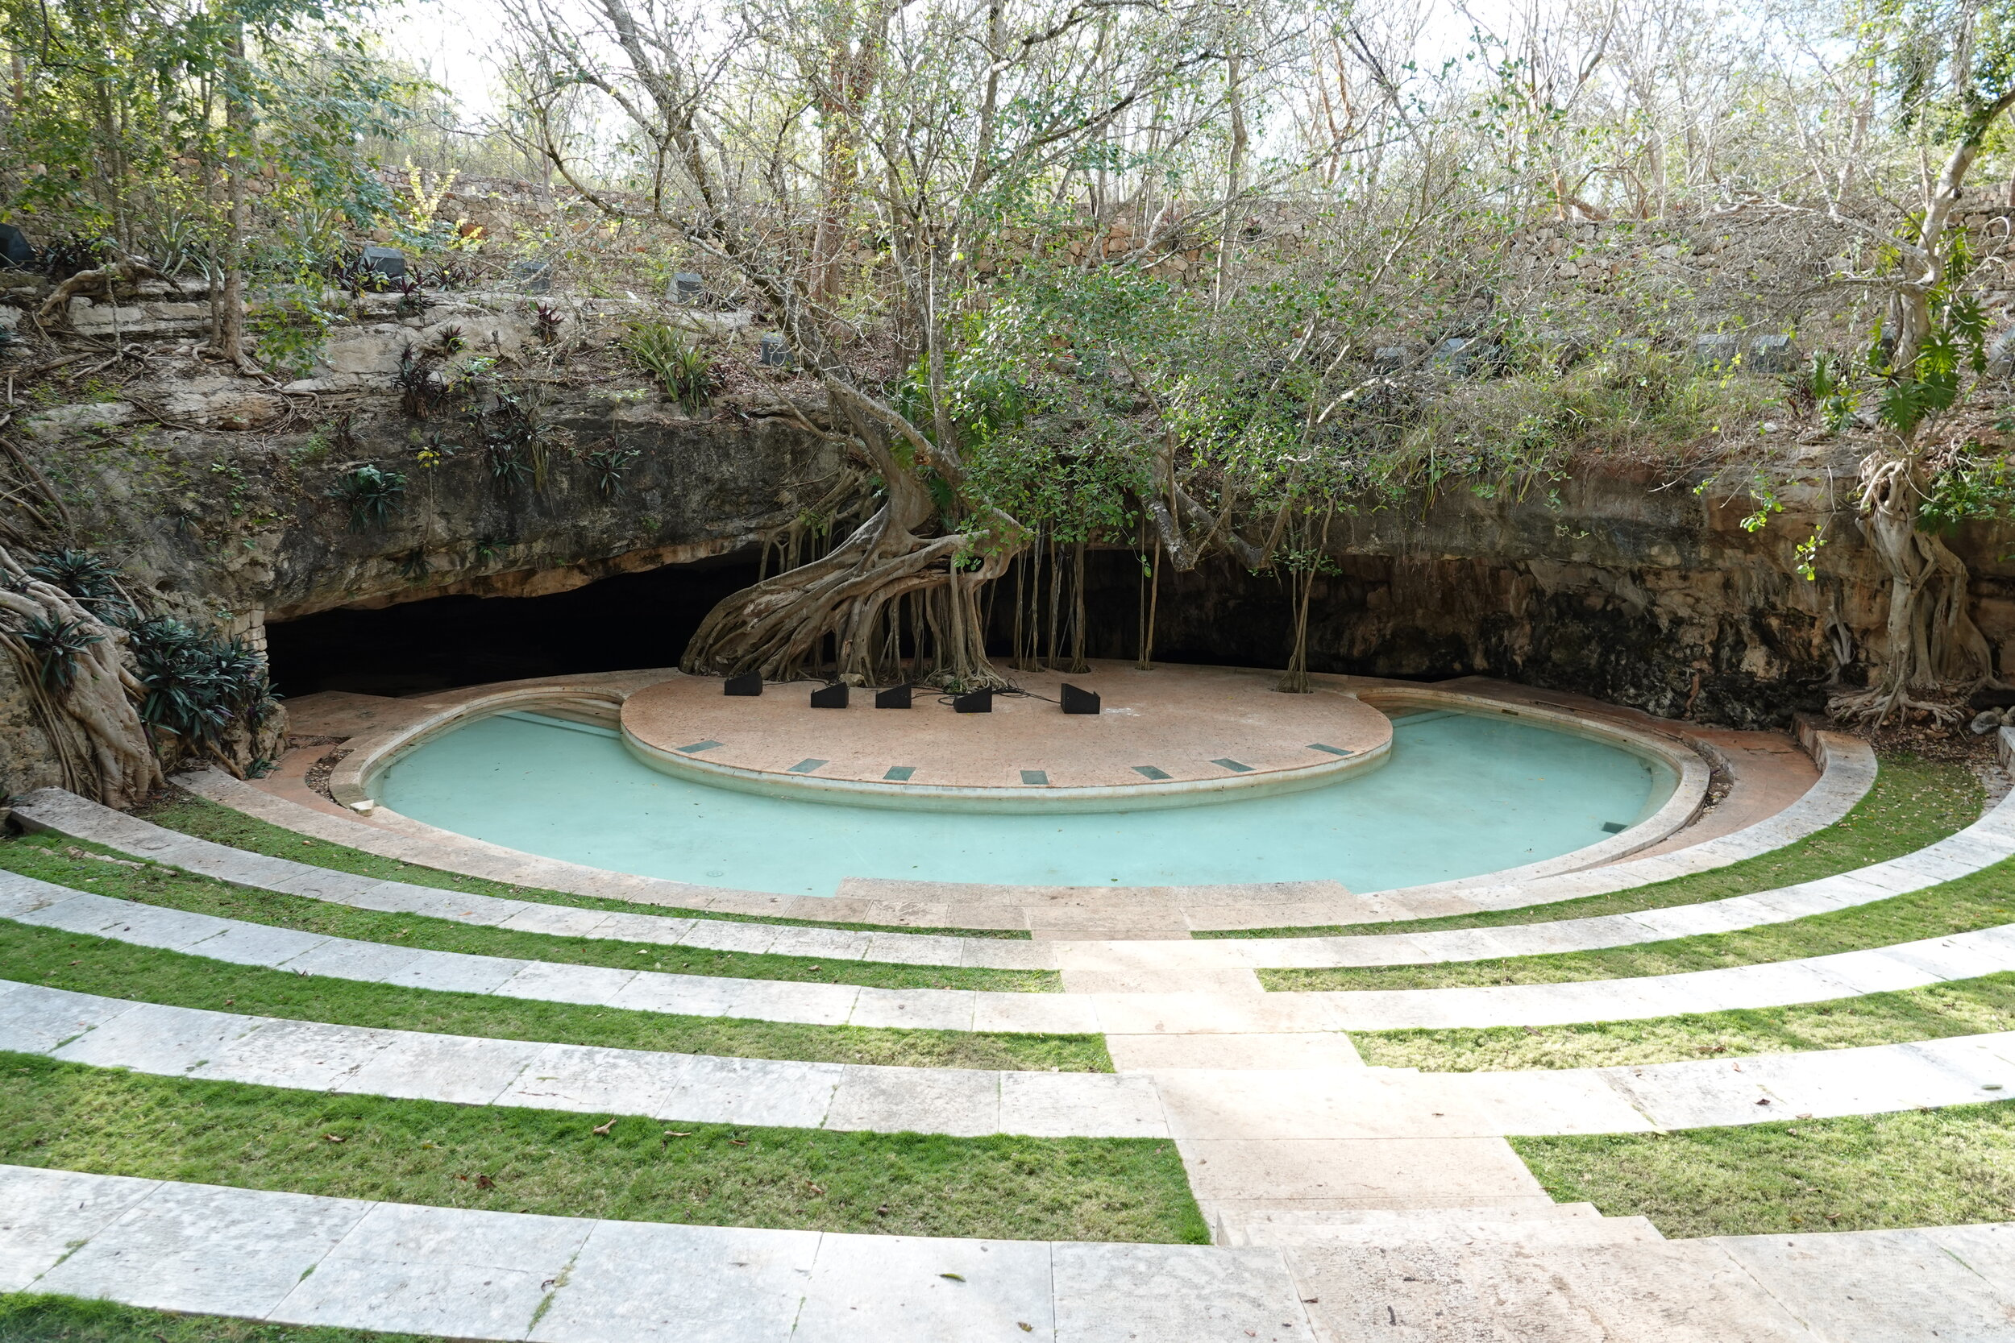
PUBLIC REALM ANALYSIS
COMMUNITY INPUT WORKSHOP
STRATAGIES FOR IMPROVING THE QUALITY OF THE PUBLIC REALM
Public investment in multi-modal street improvements
Enhanced open spaces (parks and plazas)
Thoughtful design and placement of civic buildings
Placemaking
MULTI-MODAL STREETS
F A R M I N G T O N
CIVIC BUILDINGS
O F
C I T Y
PLACEMAKING
OPEN SPACE ENHANCEMENTS

Slide 39
PRIVATE REALM ANALYSIS
COMMUNITY INPUT WORKSHOP
PRIVATE REALM DIAGRAM
The Private Realm consists of the privately owned and maintained properties and buildings that reside within the structure of the Public Realm. This includes all residential and business uses that are situated on private property. The quality of the private realm, especially in the way that a building addresses the street, has an impact on the quality of the public realm.
In the Animas Area, the private realm is dominated by marginal industrial buildings, many of which are underutilized. In addition, there are many vacant sites that blite the neighborhood.
The building stock improves in the vicinity of downtown and along Broadway. To the west, new market rate and senior housing contribute to a higher quality private realm.
F A R M I N G T O N
O F
C I T Y

Slide 40
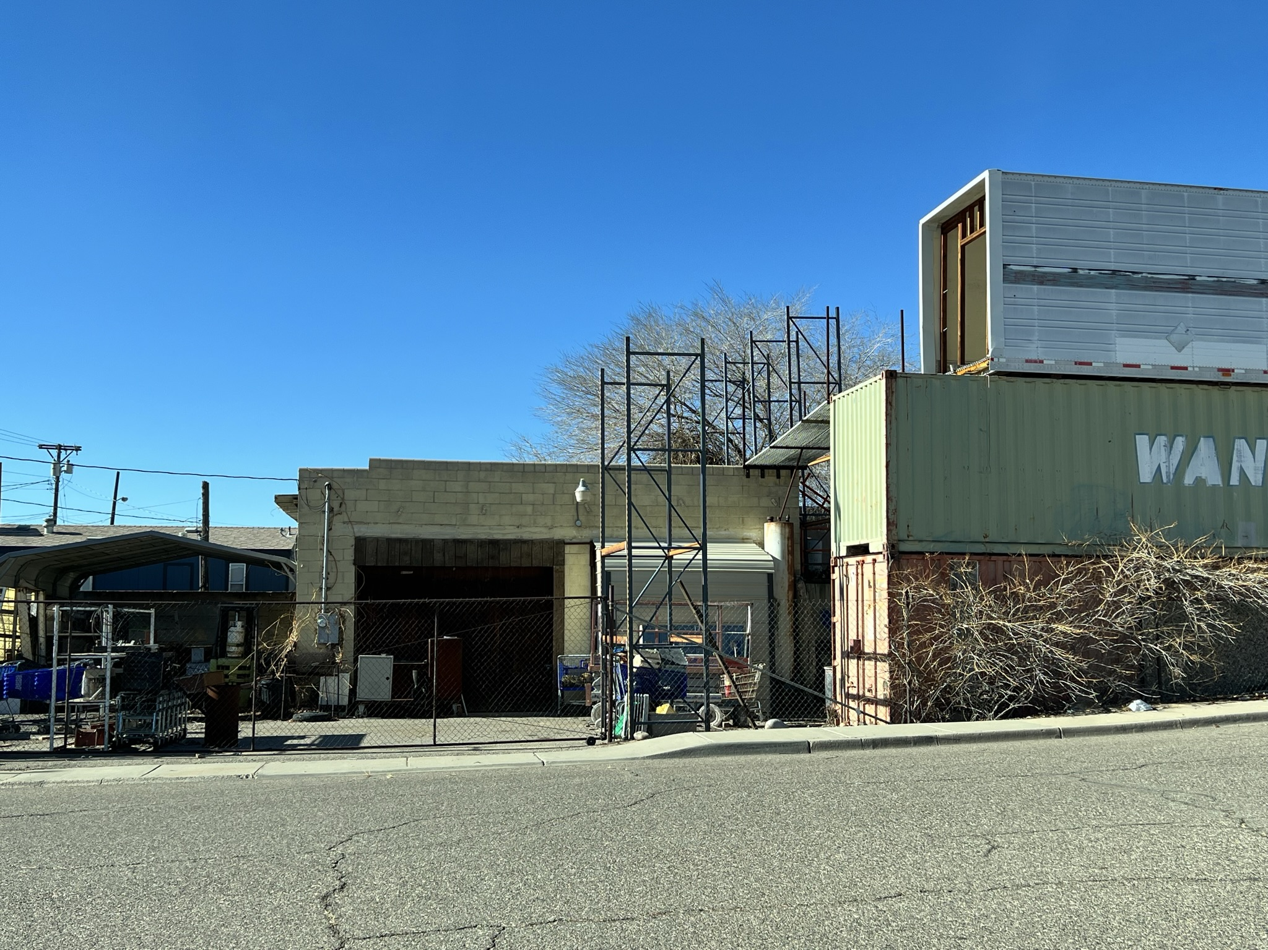
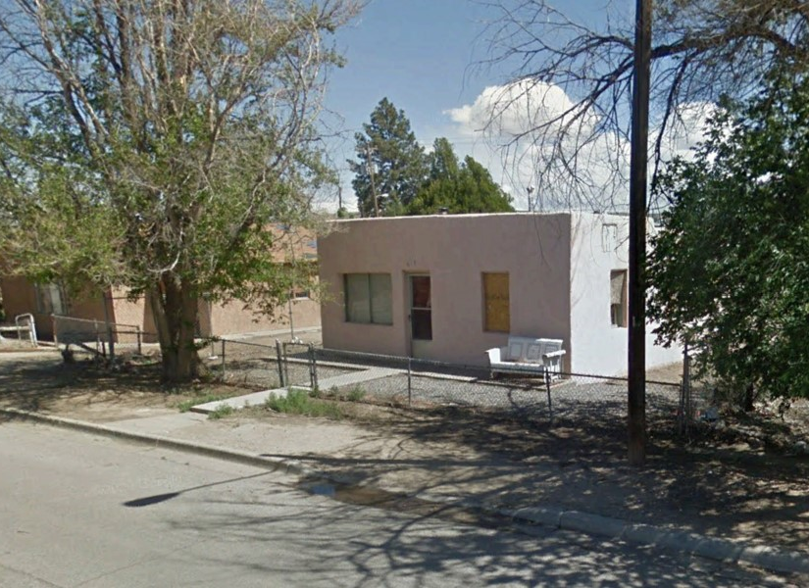
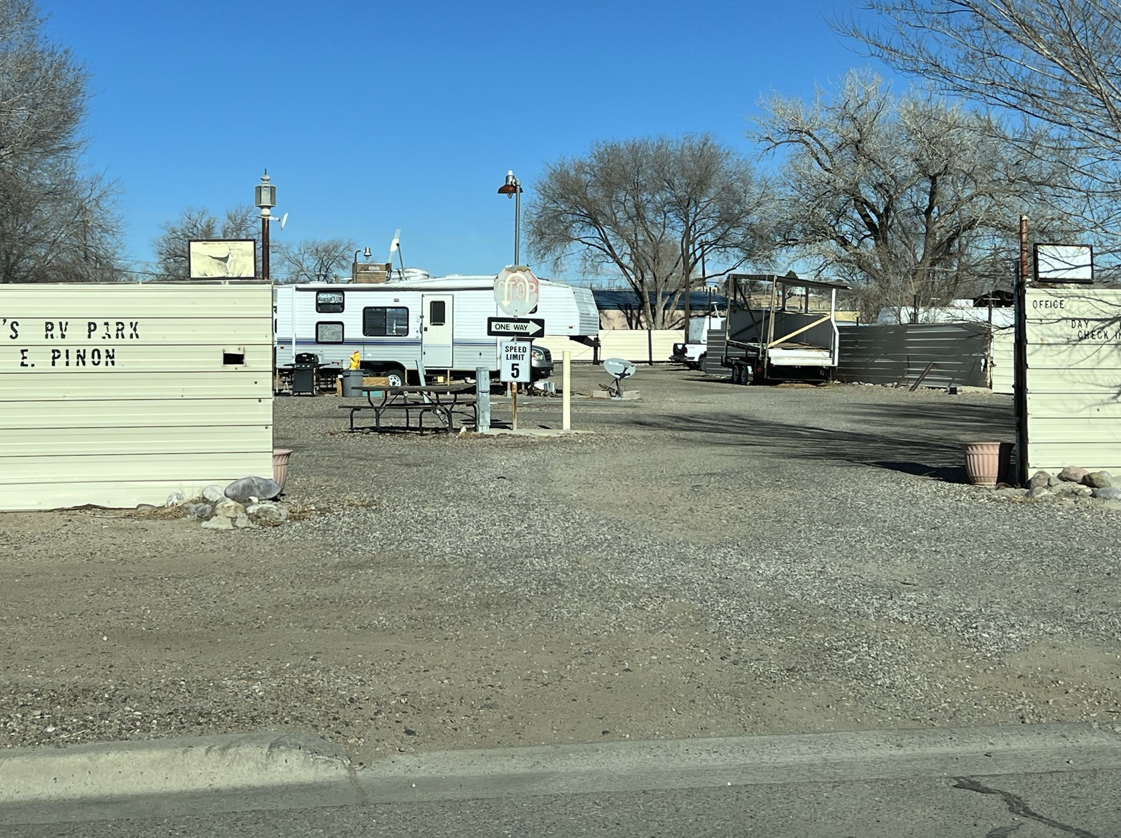
PRIVATE REALM ANALYSIS
C O N D I T I O N S
/ / PRIV A TE REALM DIA GRAM
F A R M I N G T O N
O F
C I T Y

Slide 41
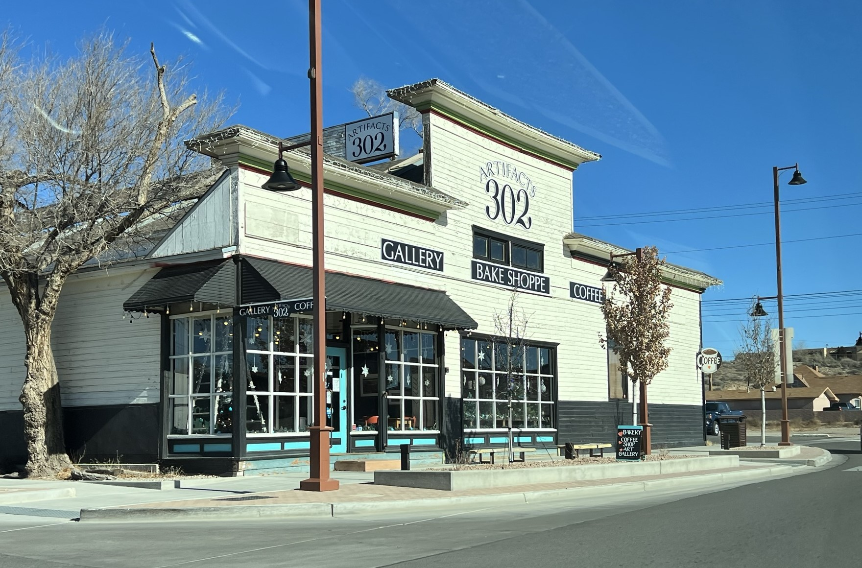
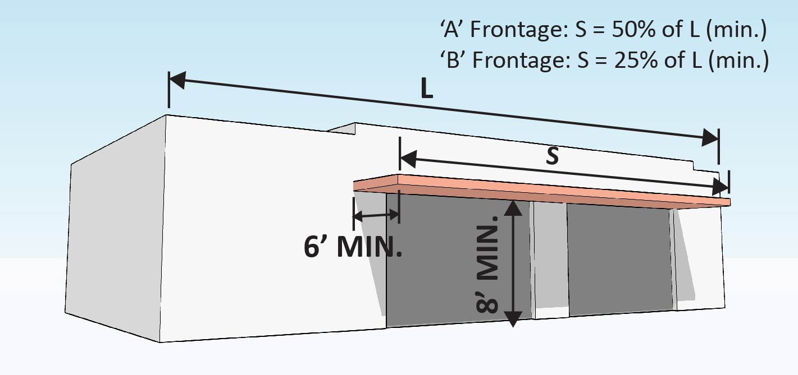
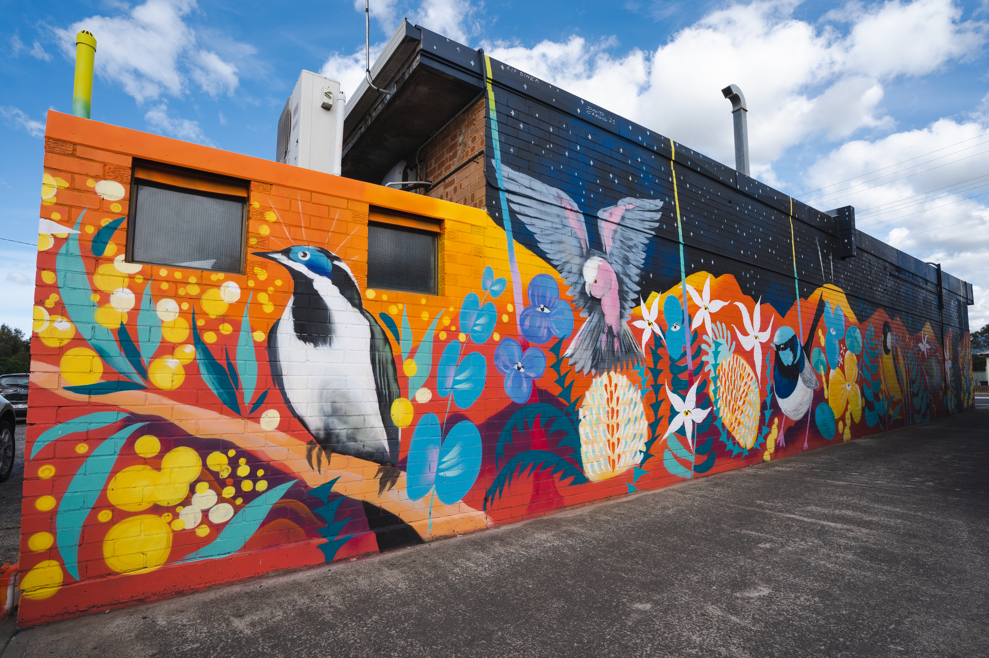
PRIVATE REALM ANALYSIS
COMMUNITY INPUT WORKSHOP
STRATEGIES FOR IMPROVING THE QUALITY OF THE PRIVATE REALM
Zoning that facilitates the vision and streamlines desired outcomes
Code enforcement
Incentives for adaptive re-use
Mural programs
Vacant Building Permit (proposed in the MRA Plan)
F A R M I N G T O N
ADAPTIVE REUSE
ZONING AND DESIGN STANDARDS
O F
C I T Y
MURAL PROGRAM FOR BLANK WALLS
CODE ENFORCEMENT

Slide 42
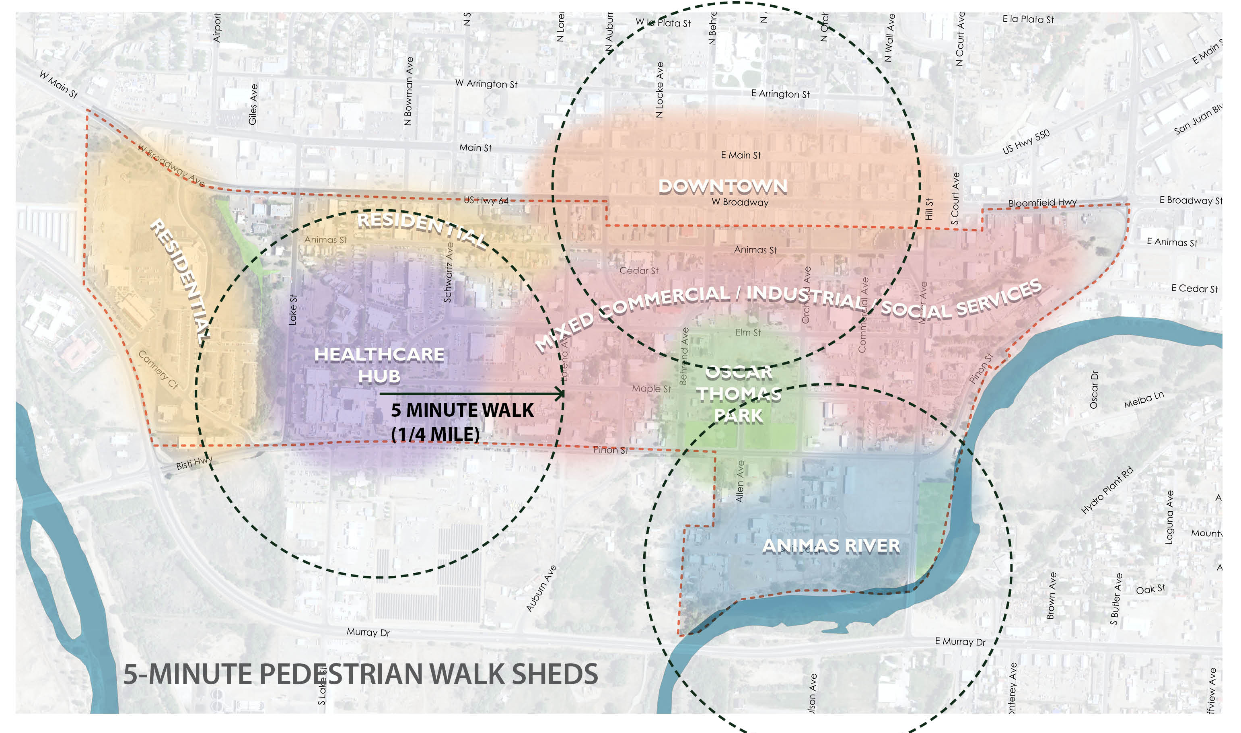
WALKABILITY
COMMUNITY INPUT WORKSHOP
PEDESTRIAN WALK SHEDS
The Pedestrian Walk Shed is a term used to describe the area that can be accessed within a 5-minute walk of the center. A 5-minute walk is typically associated with a distance of a quarter mile. It has been accepted that a person will be willing to walk a quarter mile (typically 3-4 blocks) before choosing an alternative means of transportation (usually a car).
As can be seen from the diagram, the Animas area covers a larger area than most people would choose to traverse by foot. However, walkability should be encouraged within each walk shed and other means of transportation – such as bikes and other forms of micro-mobility - should be facilitated to traverse the entire area.
F A R M I N G T O N
O F
C I T Y

Slide 43
WALKABILITY
COMMUNITY INPUT WORKSHOP
DISTANCE BETWEEN DESTINATIONS
This diagram shows the approximate distances between the areas three major destinations. While each segment might be perceived as a long walk, they are good candidates for a bike ride or other form of micromobility.
F A R M I N G T O N
O F
C I T Y

Slide 44
EXISTING PEDESTRIAN FACILITIES
This diagram identifies the existing sidewalks and utilizes a color-coded rating system showing the quality of the pedestrian realm. As can be seen, there are many gaps in the pedestrian network which inhibit walkability and safety. Again, this is largely due to the areas industrial history where walkability was not prioritized.
COMMUNITY INPUT WORKSHOP
A-rated sidewalk: Provides several of the following elements: Shade, protection from moving traffic (trees and on-street parking), seating, lighting, bike racks.
B-rated sidewalk: Provides only one or two of the elements listed above.
O F
C I T Y
C-rated sidewalk: provides a physical walking space with no amenities.

Slide 45
POPULATION TRENDS
COMMUNITY INPUT WORKSHOP
SOCIOECONOMIC, HOUSING, ECONOMIC | Block Group 1, Tract 4.02
1,167
Population
F A R M I N G T O N
346
Households
2.54
Household Size
O F
$29,295
Median HH Income
C I T Y

Slide 46
AREA POPULATION
COMMUNITY INPUT WORKSHOP
F A R M I N G T O N
O F
C I T Y

Slide 47
HOUSING UNIT YEAR BUILT
COMMUNITY INPUT WORKSHOP
F A R M I N G T O N
O F
C I T Y

Slide 48
AREA EMPLOYMENT
COMMUNITY INPUT WORKSHOP
 | Businesses |  | Employees
by NAICS Codes | Number | Percent | Number | Percent
Agriculture, Forestry, Fishing & Hunting | 0 | 0.0% | 0 | 0.0%
Mining | 0 | 0.0% | 0 | 0.0%
Utilities | 0 | 0.0% | 0 | 0.0%
Construction | 20 | 0.0% | 209 | 5.0%
Manufacturing | 5 | 0.0% | 103 | 2.5%
Wholesale Trade | 6 | 3.1% | 51 | 1.2%
Retail Trade | 26 | 13.5% | 234 | 5.6%
Transportation & Warehousing | 2 | 1.0% | 9 | 0.2%
Information | 5 | 2.6% | 32 | 0.8%
Finance & Insurance | 4 | 2.1% | 14 | 0.3%
Real Estate, Rental & Leasing | 7 | 3.6% | 24 | 0.6%
Professional, Scientific & Tech Services | 10 | 5.2% | 91 | 2.2%
Management of Companies & Enterprises | 0 | 0.0% | 0 | 0.0%
Administrative & Support & Waste Management & Remediation Services | 2 | 1.0% | 44 | 1.1%
Educational Services | 2 | 1.0% | 5 | 0.1%
Health Care & Social Assistance | 58 | 30.2% | 2,822 | 68.0%
Arts, Entertainment & Recreation | 2 | 1.0% | 5 | 0.1%
Accommodation & Food Services | 5 | 2.6% | 103 | 2.5%
Other Services (except Public Administration) | 19 | 9.9% | 102 | 2.5%
Public Administration | 13 | 6.8% | 299 | 7.2%
Unclassified Establishments | 6 | 3.1% | 5 | 0.1%
Total | 192 | 100.0% | 4,152 | 100.0%
F A R M I N G T O N
O F
C I T Y

Slide 49
ZONING BARRIERS TO REDEVELOPMENT
COMMUNITY INPUT WORKSHOP
Current zoning does not coalesce to implement any wholistic vision for the Animas Area
Most zoning districts (General Commercial and Industrial) are single use zoning districts and do not allow multi-family residential uses by right
Significant existing industrial zoning does not encourage private reinvestment due to unpredictability of adjacency
Difficult to create any critical mass or sense of place with mixed use zoning applied on a lot-by-lot basis (has to be applied to a larger area which can create critical mass with adjacency predictability)
Density standards for multi-family and mixed-use zones defaults to lot size
Parking standards are static (and suburban) and inhibit ability for buildings to accommodate changing uses over time based on the market
No building or urban design standards applicable to both the private and public realms associated with mixed-use zoning
F A R M I N G T O N
O F
C I T Y

